Slide 1






Statistical Data Analysis
RESEARCH METHODOLOGY AND DATA ANALYSIS
Workshop conducted by KSTA and VTU
Today's Topic
Dr. Tanujit Chakraborty
Assistant Professor of Statistics @ Sorbonne University
Mphasis Research Fellow @ IIIT Bangalore
GitHub: https://github.com/mad-stat/KSTA_Workshop

Slide 2
Today’s Topics…
Role of Statistics and Data Analysis
Data summarization
Concepts of Descriptive Statistics
Statistical Inference
Point Estimation
Interval Estimation
Hypothesis Testing
Analysis of Variance
Relationship Analysis
Correlation Analysis
Linear Regression

Slide 3
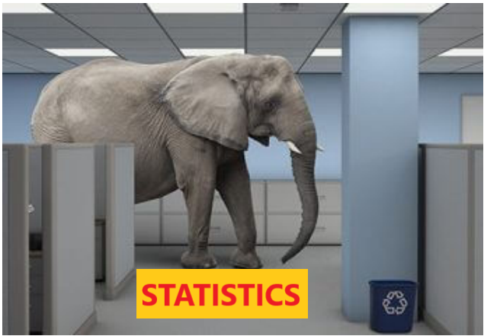
What is Statistics?

Slide 4
Introduction
We encounter data and make conclusions based on data every day.
Statistics is the scientific discipline that provides methods to help us make sense of data.
Statistical methods, used intelligently, offer a set of powerful tools for gaining insight into the world around us.
The field of statistics teaches us how to make intelligent judgments and informed decisions in the presence of uncertainty and variation.

Slide 5
Why Study Statistics?
Studying statistics will help us to collect data in a sensible way and then use the data to answer questions of interest.
Studying statistics will allow us to critically evaluate the work of others by providing with the tools we need to make informed judgments.
Throughout our personal and professional life, we will need to
understand and use data to make decisions.
To do this, we must be able to
Decide whether existing data is adequate or whether additional information is required.
If necessary, collect more information in a reasonable and thoughtful way.
Summarize the available data in a useful and informative manner.
Analyse the available data.
Draw conclusions, make decisions, and assess the risk of an incorrect
decision.

Slide 6
The Nature and Role of Variability
Statistical methods allow us to collect, describe, analyse and draw conclusions from data.
If we lived in a world where all measurements were identical for every individual, these tasks would be simple.
Example of No Variability:
Imagine a population consisting of all students at a particular university. Suppose that every student was enrolled in the same number of courses, spent exactly the same amount of money on textbooks this semester, and favoured increasing student fees to support expanding library services. For this population, there is no variability in number of courses, amount spent on books, or student opinion on the fee increase.
Example of Variability:
Let us consider the Mathematics score of all student of a particular batch.
44 33 43 43 48 30 41 35 31 45
31 30 44 41 35 33 45 35 31 41

Slide 7
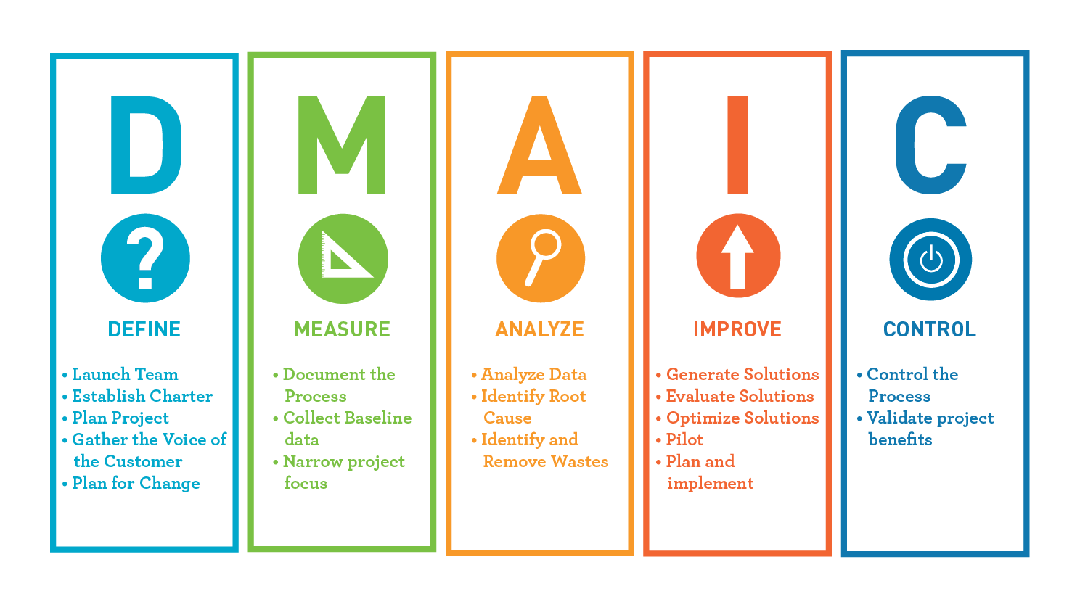
Statistics and the Data Analysis Process
The data analysis process can be viewed as a sequence of steps that lead from planning to data collection to making informed conclusions based on the resulting data.

Slide 8


Example
The admissions director at a large university might be interested in learning why some applicants who were accepted for the fall 2010 term failed to enroll at the university.
The population of interest to the director consists of all accepted applicants
who did not enroll in the fall 2021 term.
Because this population is large and it may be difficult to contact all the individuals, the director might decide to collect data from only 300 selected students.
These 300 students constitute a sample.
Deciding how to select the 300 students and what data should be collected
from each student are steps 2 and 3 in the data analysis process.

Slide 9
Example (Continued)
The next step in the process involves organizing and summarizing data.
Methods for organizing and summarizing data, such as the use of tables, graphs, or numerical summaries, make up the branch of statistics called descriptive statistics.
The second major branch of statistics, inferential statistics, involves
generalizing from a sample to the population from which it was selected.
When we generalize in this way, we run the risk of an incorrect conclusion, because a conclusion about the population is based on incomplete information.
An important aspect in the development of inferential techniques involves quantifying the chance of an incorrect conclusion.

Slide 10
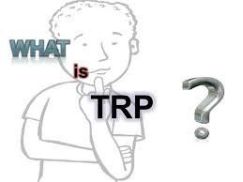
TRP: An example
Television rating point (TRP) is a tool provided
to judge which programs are viewed the most.
This gives us an index of the choice of the people and also the popularity of a particular channel.
For calculation purpose, a device is attached to the TV sets in few
thousand viewers’ houses in different geographic and demographic sectors.
The device is called as People's Meter. It reads the time and the programme that a viewer watches on a particular day for a certain period.
An average is taken, for example, for a 30-days period.
The above further can be augmented with a personal interview survey
(PIS), which becomes the basis for many studies/decision making.
Essentially, we are to analyze data for TRP estimation.

Slide 11

Data
Definition : Data
A set of data is a collection of observed values representing one or more characteristics of some objects or units.
Example: For TRP, data collection consist of the following attributes.
Age: A viewer’s age in years
Sex: A viewer’s gender coded 1 for male and 0 for female
Happy: A viewer’s general happiness
NH for not too happy
PH for pretty happy
VH for very happy
TVHours: The average number of hours a respondent watched TV during a day

Slide 12
Data : Example
Viewer# | Age | Sex | Happy | TVHours
… | … | … | … | …
… | … | … | … | …
55 | 34 | F | VH | 5
… | … | … | … | …
Note:
A data set is composed of information from a set of units.
Information from a unit is known as an observation.
An observation consists of one or more pieces of information about a unit; these are called variables.

Slide 13

Type of Data
Variables:
A characteristic that varies from one person or thing to another is called a
variable.
Example: height, weight, sex, marital status etc.
Quantitative (or Numerical) Variable:
A variable is numerical (or quantitative) if each observation is a number. Example: height, weight etc.
Qualitative (or Categorical) Variable:
A variable is categorical (or qualitative) if the individual observations are categorical responses.
Example: sex, marital status etc.

Slide 14
Type of Data
Quantitative variable can also be classified as either discrete or continuous.
Discrete Variable:
A variable is discrete if it has only a countable number of distinct possible
values i.e. a variable is discrete if it can assume only a finite numbers of values.
Example: Number of defects.
Continuous Variable:
A numerical variable is called continuous variables if the set of possible values forms an entire interval on the numerical line.
Example: Length, temperature etc.
Data: A collection of observations on one or more variables is called data.

Slide 15
Data Summarization
To identify the typical characteristics of data (i.e., to have an overall picture).
To identify which data should be treated as noise or outliers.
The data summarization techniques can be classified
categories:
into two broad
Measures of location
Measures of dispersion

Slide 16
Measurement of location
It is also alternatively called as measuring the central tendency.
A function of the sample values that summarizes the location information into a single number is known as a measure of location.
The most popular measures of location are
Mean
Median
Mode
These can be measured in three ways
Distributive measure
Algebraic measure
Holistic measure

Slide 17
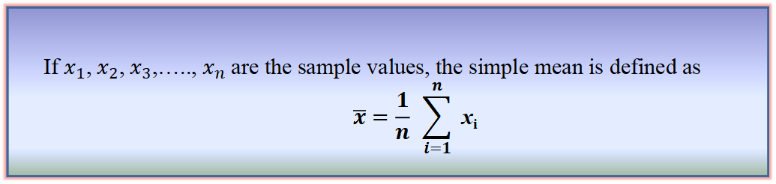
Simple mean / Arithmetic Mean / Average
If $x_{1}$, $x_{2}$, $x_{3}$,….., $x_{n}$ are the sample values, the simple mean is defined as
$$\overline{x}=\frac{1}{n} \sum_{i=1}^{n}{ \text{x}\text{i}}$$
Definition : Simple mean
It cannot be used if we are dealing with qualitative data.
It cannot be obtained if a single observation is missing.
It affected very much by extreme values.
It may lead to wrong conclusions if the details of the data from which it is computed are not given.
Disadvantages of Simple mean

Slide 18
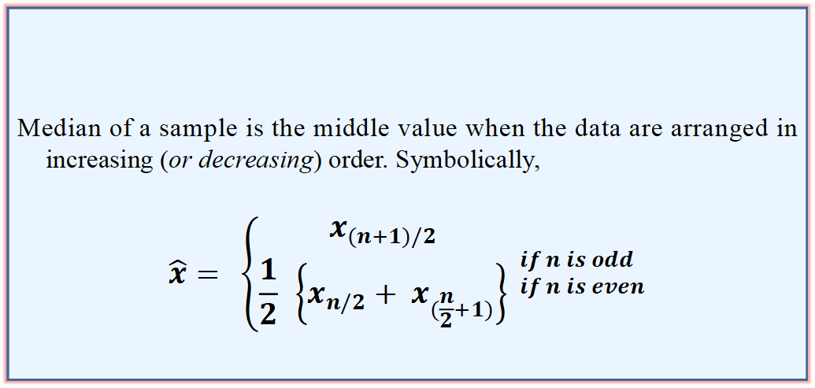
Median
Median of a distribution is the value of the variable which divides it into two equal parts.
Median is not at all affected by extreme values
Median of a sample is the middle value when the data are arranged in increasing (or decreasing) order. Symbolically,
$$\hat{x}= \left\{\begin{aligned}x_{(n+1)/2} \\ \frac{1}{2} \left\{x_{n/2}+ x_{(\frac{n}{2}+1)}\right\}\end{aligned}\right. _{if n is even}^{if n is odd}$$
Definition : Median of a sample

Slide 19
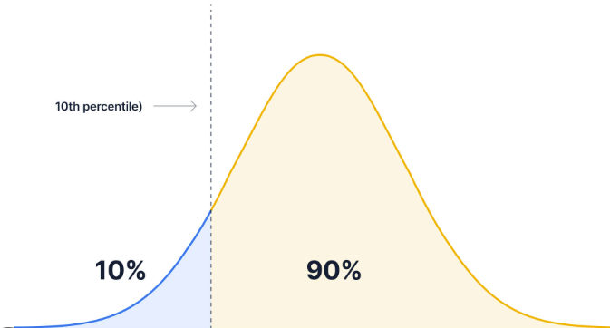
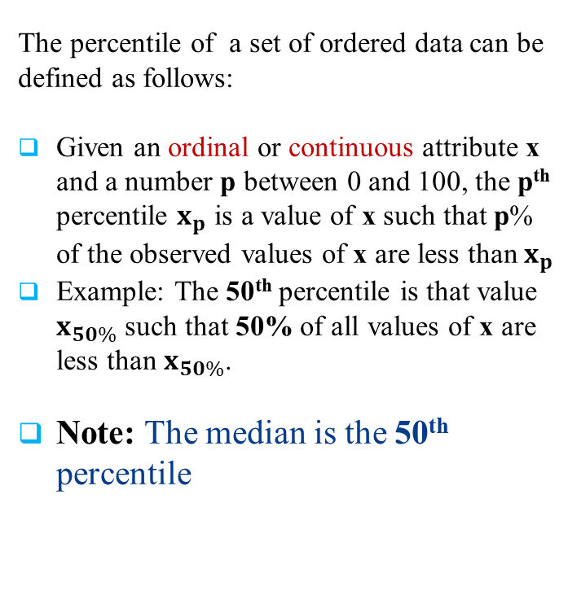
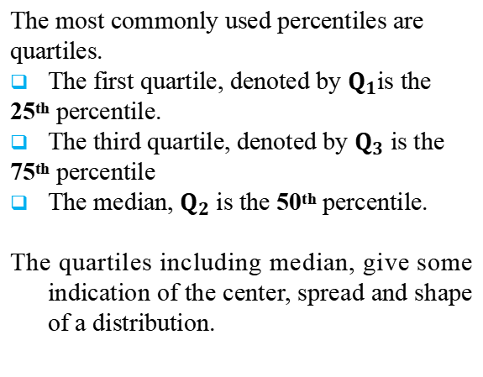
Percentile
Quartile
The percentile of a set of ordered data can be defined as follows:
Given an ordinal or continuous attribute x and a number p between 0 and 100, the p^{th} percentile $x_{p}$ is a value of x such that p% of the observed values of x are less than $x_{p}$
Example: The 50th percentile is that value $x_{50\%}$ such that 50% of all values of x are less than $x_{50\%}$.
Note: The median is the 50th percentile
The most commonly used percentiles are quartiles.
The first quartile, denoted by $Q_{1}$is the 25th percentile.
The third quartile, denoted by $Q_{3}$ is the 75th percentile
The median, $Q_{2}$ is the 50th percentile.
The quartiles including median, give some indication of the center, spread and shape of a distribution.

Slide 20
Mode of a sample
Mode is defined as the observation which occurs most frequently.
For example, number of wickets obtained by bowler in 10 test matches are as follows.
1 2 0 3 2 4 1 1 2 2
In other words, the above data can be represented as:-
value | 0 | 1 | 2 | 3 | 4
# of matches | 1 | 3 | 4 | 1 | 1
Clearly, the mode here is “2”.
If a distribution has two modes, then it is called bimodal.

Slide 21
Measures of dispersion
Location measure are far too insufficient to understand data.
Another set of commonly used summary statistics for continuous data are those that measure the dispersion.
A dispersion measures the extent of spread of observations in a sample.
Some important measure of dispersion are:
Range
Variance and Standard Deviation
Interquartile Range (IQR)

Slide 22
Measures of dispersion
Example
Suppose, two samples of fruit juice bottles from two companies A and B. The
unit in each bottle is measured in litre.
Sample A | 0.97 | 1.00 | 0.94 | 1.03 | 1.06
Sample B | 1.06 | 1.01 | 0.88 | 0.91 | 1.14
Both samples have same mean. However, the bottles from company A with more uniform content than company B.
We say that the dispersion (or variability) of the observation from the average is less for A than sample B.
The variability in a sample should display how the observation spread out from the average
In buying juice, customer should feel more confident to buy it from A than B

Slide 23

Range of a sample
Definition : Range of a sample
Let X = 𝐱_{𝟏},….., 𝐱_{𝐧} be n sample values that are arranged in increasing
order.
The range R of these samples is then defined as:
R = max(X) – min(X) = 𝐱_{𝐧} - 𝐱_{𝟏}
= Largest observation – Smallest observation
Range identifies the maximum spread, it can be misleading if most of the values are concentrated in a narrow band of values, but there are also a relatively small number of more extreme values.
The variance is another measure of dispersion to deal with such a situation.

Slide 24
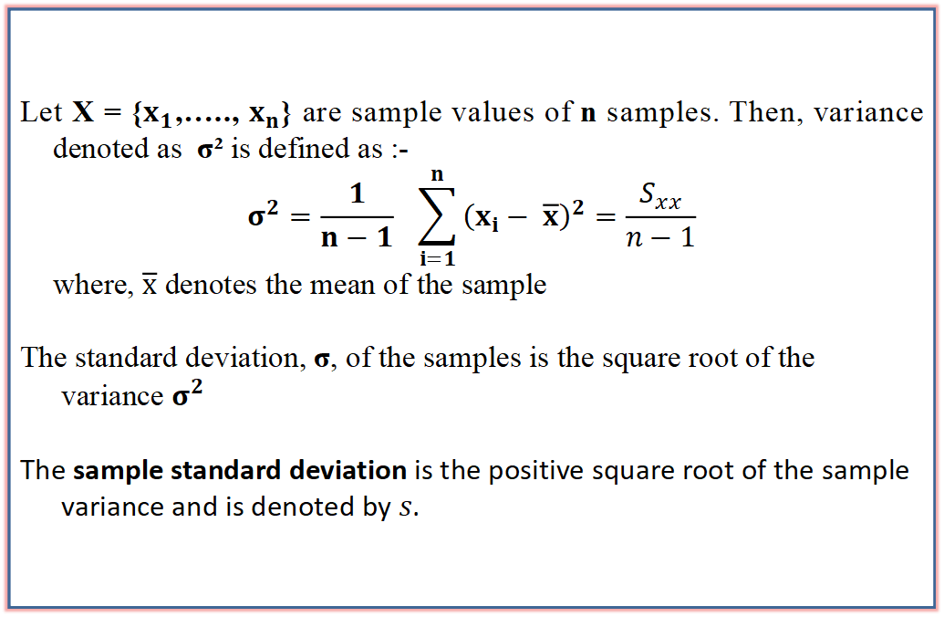
Variance and Standard Deviation
Let X = {$x_{1}$,….., $x_{n}$} are sample values of n samples. Then, variance denoted as σ² is defined as :-
$$σ^{2}=\frac{1}{n−1} \sum_{i=1}^{n}{{\left(x_{i}− \overline{x}\right)}^{2}}=\frac{S_{xx}}{n−1}$$
where, $\overline{x}$ denotes the mean of the sample
The standard deviation, σ, of the samples is the square root of the variance $σ^{2}$
The sample standard deviation is the positive square root of the sample variance and is denoted by $s$.
Definition : Variance and Standard Deviation

Slide 25
Interquartile Range
Interquartile range, denoted as IQR is a robust measure of dispersion.
To understand IQR, let us first define percentile and quartile
Percentile
The percentile of a set of ordered data can be defined as follows:
Given an ordinal or continuous attribute x and a number p between 0 and 100, the p^{th} percentile 𝐱_{𝐩} is a value of x such that p% of the observed values of x are less than 𝐱_{𝐩}
Example: The 50th percentile is that value 𝐱_{𝟓𝟎%} such that 50% of all values
of x are less than 𝐱_{𝟓𝟎%}.
Note: The median is the 50th percentile.

Slide 26
Interquartile Range
The distance between 𝐐_{𝟏} and 𝐐_{𝟑} is a simple measure of spread that gives the range covered by the middle half of the data. This distance is called the interquartile range (IQR) and is defined as
IQR = 𝐐_{𝟑} - 𝐐_{𝟏}
Application of IQR
Outlier detection using five-number summary
A common rule of the thumb for identifying suspected outliers is to single out values falling at least 1.5 × IQR above 𝐐_{𝟑} and below 𝐐_{𝟏}
In other words, extreme observations occurring within 1.5 × IQR of the quartiles

Slide 27

Five point summary
Since, 𝐐_{𝟏}, 𝐐_{𝟐} and 𝐐_{𝟑} together contain no information about the endpoints of the data, a complete summary of the shape of a distribution can be obtained by providing the lowest and highest data value as well. This is known as the five-number summary
The five-number summary of a distribution consists of :
The Median 𝐐_{𝟐}
The first quartile 𝐐_{𝟏}
The third quartile 𝐐_{𝟑}
The smallest observation
The largest observation
These are, when written in order gives the five-number summary: Minimum, 𝐐_{𝟏}, Median (𝐐_{𝟐}), 𝐐_{𝟑}, Maximum

Slide 28
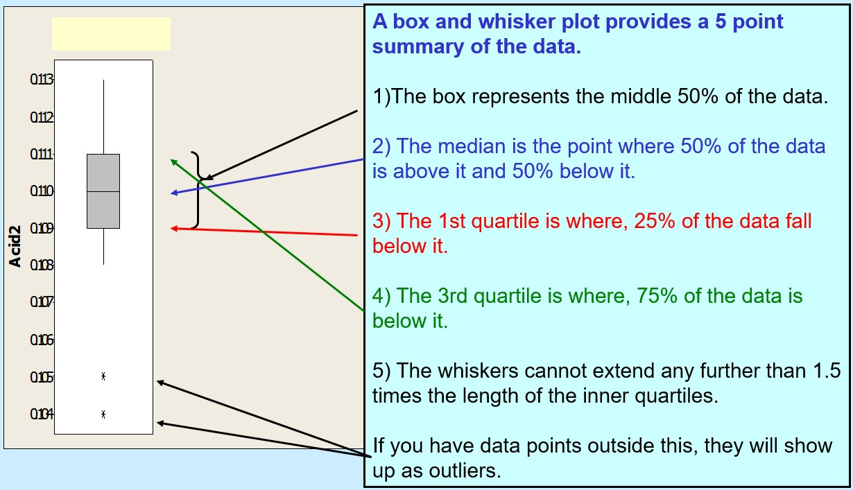
Box plot

Slide 29
Statistical Inference
Descriptive analysis is valid only for the data set under consideration and cannot necessarily be generalized to other data.
Statistical Inference allows us to infer from the sample data about the population of interest.
It is not feasible to consider entire population for a analysis, hence we need to collect a representative sample.
There are two facts, which are key to statistical inference.
Population parameters are fixed number whose values are usually unknown.
Sample statistics are known values for any given sample, but vary from sample to sample, even taken from the same population.
In fact, it is unlikely for any two samples drawn independently, producing identical values of sample statistic.

Slide 30
STATISTICAL INFERENCE
ST
Parametric Inference
(When the population distribution is known, we apply parametric inference.)
Non-Parametric Inference
(When we have no information regarding the population distribution, we apply non-parametric inference.)
Point Estimation
Test of Hypothesis
Interval Estimation
Fig.: Taxonomy of Statistical Inference

Slide 31
Basic Inferential Approaches
Approach 1: Point and Confidence interval measurement
We estimate one (or more) parameter(s) using sample statistics.
This estimation can be done in the form of a single estimated value (Point Estimation)
This estimation usually done in the form of an interval (Interval Estimation).
Accuracy of the decision is expressed as the level of confidence we have in the interval.
Approach 2: Hypothesis testing
We conduct test on hypothesis.
We hypothesize that one (or more) parameter(s) has (have) some specific value(s) or relationship.
Make our decision about the parameter(s) based on one (or more) sample statistic(s)
Accuracy of the decision is expressed as the probability that the decision is incorrect.

Slide 32
Method of Point Estimatoion -Maximum Likelihood Estimation (MLE)
Objective​:
To introduce the idea of working out the most likely cause of an observed result by considering the likelihood of each of several possible causes and picking the cause with the highest likelihood​.

Slide 33
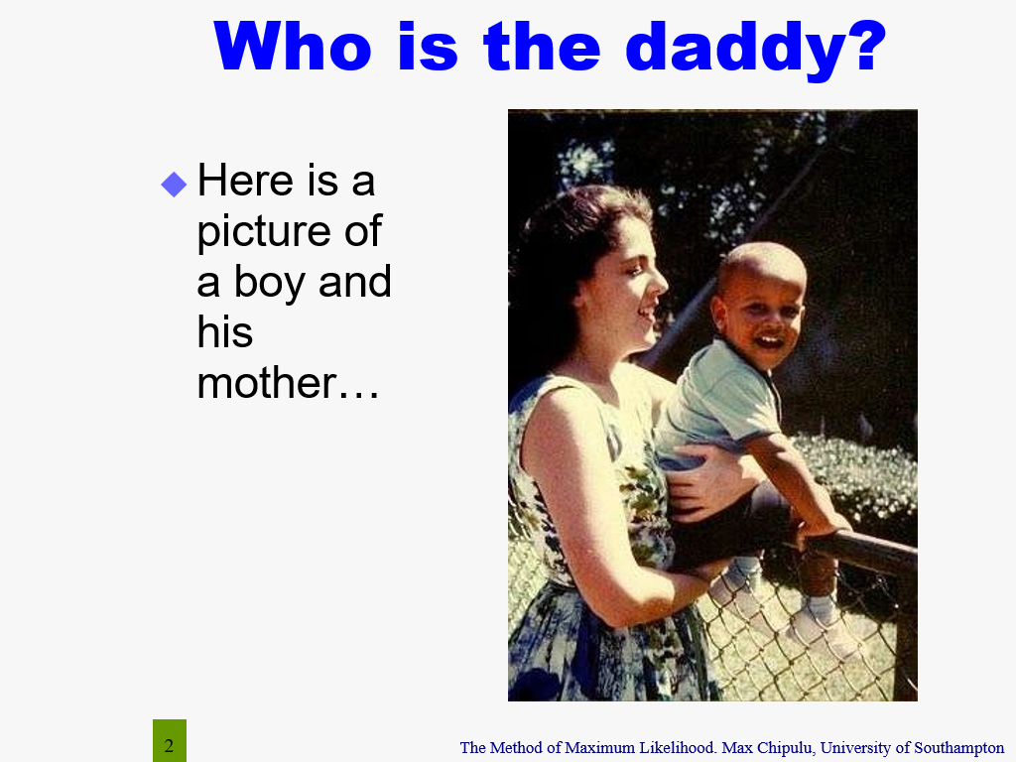
Maximum Likelihood Estimation (MLE)

Slide 34
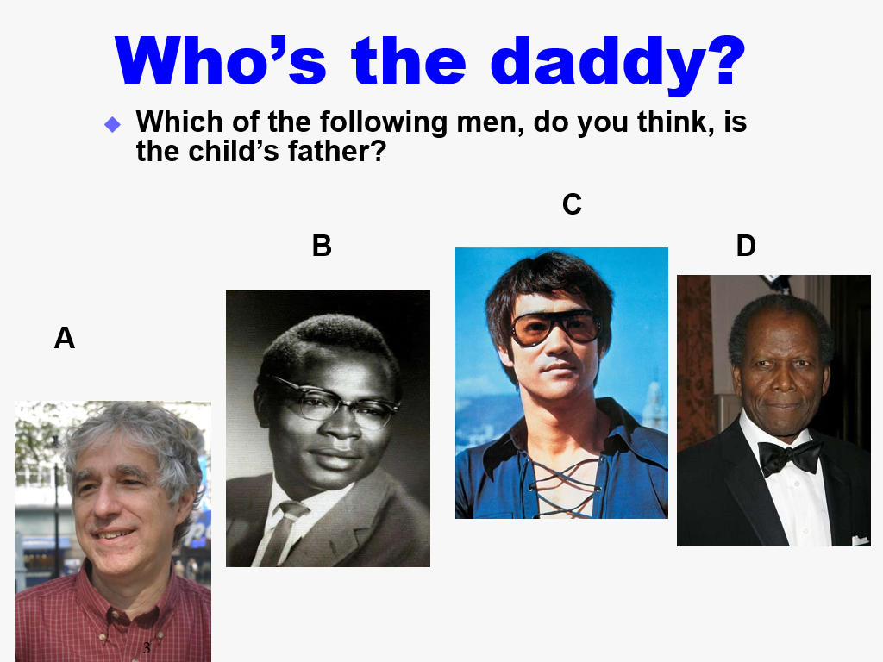
Maximum Likelihood Estimation (MLE)

Slide 35
Maximum Likelihood Estimation (MLE)
The child appears to be of mixed race parentage​.
His mother is white​.
Therefore, of the four possible daddies, daddy A is the least likely​.
Daddy C is the next least likely because of the child’s appearance​.
This leaves B or D; but which one did you go for?​
If only we had more information, e.g. blood types or DNA or history of the two men, we could be more exact in our view of which of the two is more likely....​
But we could never be certain that anyone’s daddy is the real daddy! We simply accept the most likely choice. Every daddy is an MLE daddy!​

Slide 36
Did you guess…​
The child in the picture is President Barack Obama and his mother.
​
Daddy D is the actor Sydney Poitier​.
C is the actor Bruce Lee​.
A is Professor Alan Agresti- Statistics Icon​ (writer of Foundation of Statistics for Data Scientists).
B is Barack Obama, Sr.

Slide 37
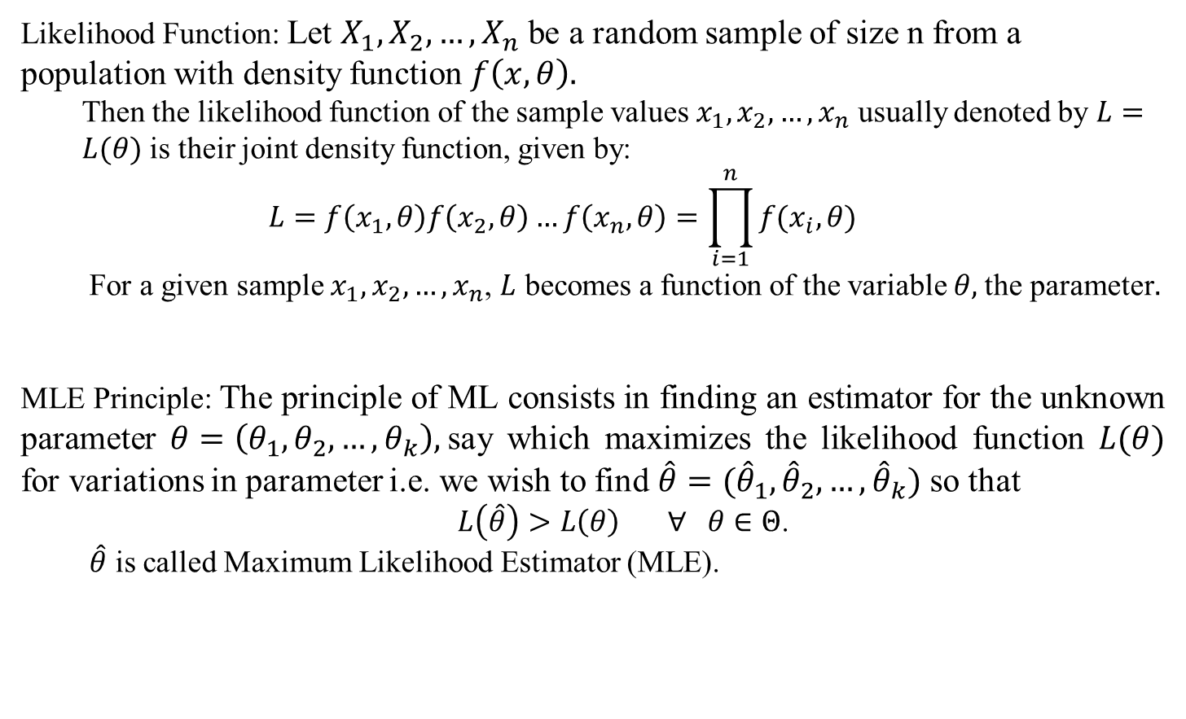
Maximum Likelihood Estimation (MLE)
Likelihood Function: Let $X_{1}, X_{2},…, X_{n}$ be a random sample of size n from a population with density function $f\left(x,θ\right).$
Then the likelihood function of the sample values $x_{1}, x_{2}, …, x_{n}$ usually denoted by $L=L(θ)$ is their joint density function, given by:
$$L=f\left(x_{1},θ\right)f\left(x_{2},θ\right)…f\left(x_{n},θ\right)=\prod_{i=1}^{n}{f(x_{i},θ)}$$
For a given sample $x_{1}, x_{2}, …, x_{n}$, $L$ becomes a function of the variable $θ,$the parameter$.$
MLE Principle: The principle of ML consists in finding an estimator for the unknown parameter $θ=\left(θ_{1},θ_{2},…, θ_{k}\right),$say which maximizes the likelihood function $L(θ)$ for variations in parameter i.e. we wish to find $\hat{θ}=({\hat{θ}}_{1},{\hat{θ}}_{2},…,{\hat{θ}}_{k})$ so that
$L\left(\hat{θ}\right)>L\left(θ\right) ∀ θ∈Θ$.
$\hat{θ}$ is called Maximum Likelihood Estimator (MLE).

Slide 38
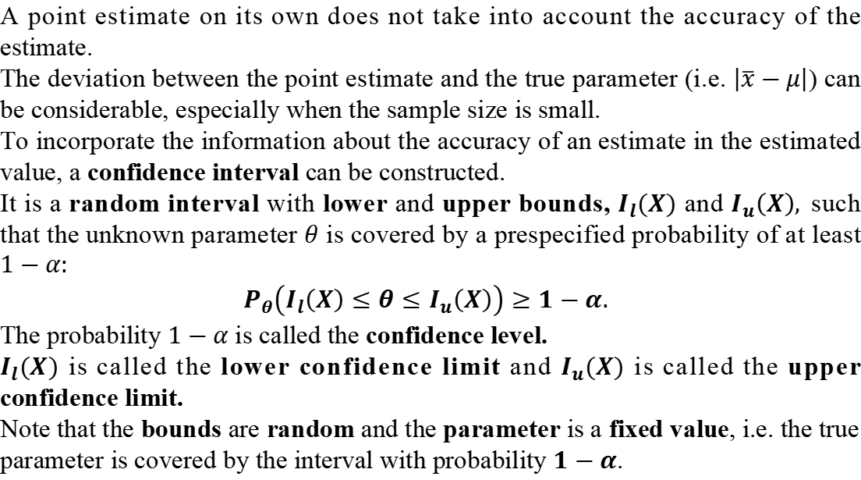
Interval Estimation
A point estimate on its own does not take into account the accuracy of the estimate.
The deviation between the point estimate and the true parameter (i.e. $\left|\overline{x}−μ\right|$) can be considerable, especially when the sample size is small.
To incorporate the information about the accuracy of an estimate in the estimated value, a confidence interval can be constructed.
It is a random interval with lower and upper bounds, $I_{l}(X)$ and $I_{u}\left(X\right),$such that the unknown parameter $θ$ is covered by a prespecified probability of at least $1−α:$
$P_{θ}\left(I_{l}\left(X\right)≤θ≤I_{u}\left(X\right)\right)≥1−α.$
The probability $1−α$ is called the confidence level.
$I_{l}(X)$ is called the lower confidence limit and $I_{u}(X)$ is called the upper confidence limit.
Note that the bounds are random and the parameter is a fixed value, i.e. the true parameter is covered by the interval with probability $1−α$.

Slide 39
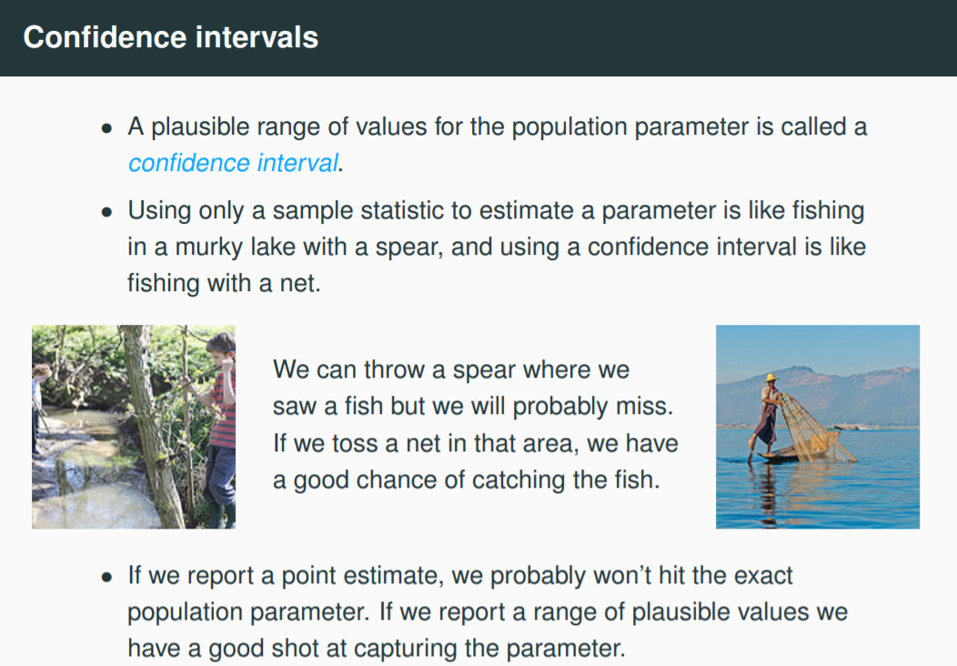
Interval Estimation

Slide 40
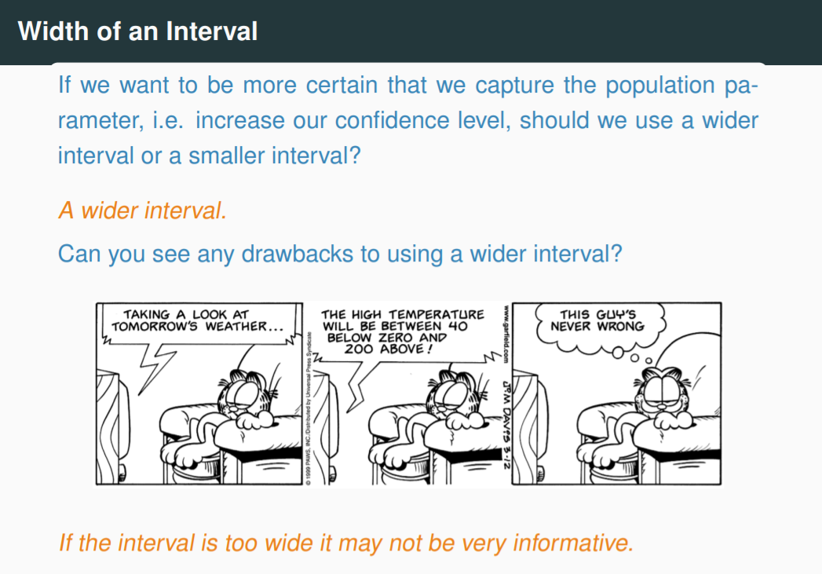
Interval Estimation

Slide 41
Introduction to Hypothesis Testing
Sometimes, we are not interested in precise estimates of a parameter, but we only want to examine whether a statement about a parameter of interest or the research hypothesis is true or not.
Another related issue is that once an analyst estimates the parameters on the basis of a random sample, he would like to infer something about the value of the parameter in the population.
Statistical hypothesis tests facilitates the comparison of estimated values with hypothetical values.

Slide 42




Hypothesis Testing
Statistical inference
Sample
Null hypothesis
Alternative hypothesis
A hypothesis about the value of a population parameter is an assertion about its value.

Slide 43
Hypothesis Testing
A useful analogy for statistical decision making is the decision process used by a jury in a legal proceeding.
In a criminal trial, the null hypothesis is that the defendant is “not guilty” ( “not” in the null hypothesis).
The alternative is, of course, that the defendant is guilty. The “benefit of the doubt” goes to the null hypothesis (i.e., the evidence must be evaluated by beginning with the assumption that the defendant is not guilty).
The “burden of proof” is on the prosecution to demonstrate that the assumption of not guilty is incorrect (i.e., evidence must be gathered to support the claim of guilty. The defendant need not prove innocence).
Jurors must only vote for guilty if they are convinced “beyond reasonable doubt” that the defendant is guilty. Basically, the decision process for a juror goes something like this.

Slide 44
Hypothesis Testing
Assume the defendant is not guilty. Evaluate the evidence in light of this assumption. Could all the evidence presented simply be a coincidence? (That is, could the degree that the evidence points to guilt of the defendant just be explained as coincidence?)
What is the chance of that? If that chance is small, then vote for guilty. Otherwise don't vote for guilty. How small is a small chance? Whatever the juror interprets as “beyond reasonable doubt.”
In statistical hypothesis testing, the principles of the trial carry through quite similarly. The null hypothesis gets the “benefit of the doubt.”
The “burden of proof” is on the alternative hypothesis. The experimenter must have a test statistic (evidence) which convinces us that the alternative is true rather than the null hypothesis.
The same question must be asked as we make a statistical decision as that asked above by the juror.

Slide 45
Statistical Hypothesis
If the hypothesis is stated in terms of population parameters (such as mean and variance), the hypothesis is called statistical hypothesis.
Data from a sample (which may be an experiment) are used to test the validity of the hypothesis.
A procedure that enables us to agree (or disagree) with the statistical hypothesis is called a test of the hypothesis.
Example :
To determine whether the wages of men and women are equal.
A product in the market is of standard quality.
Whether a particular medicine is effective to cure a disease.

Slide 46
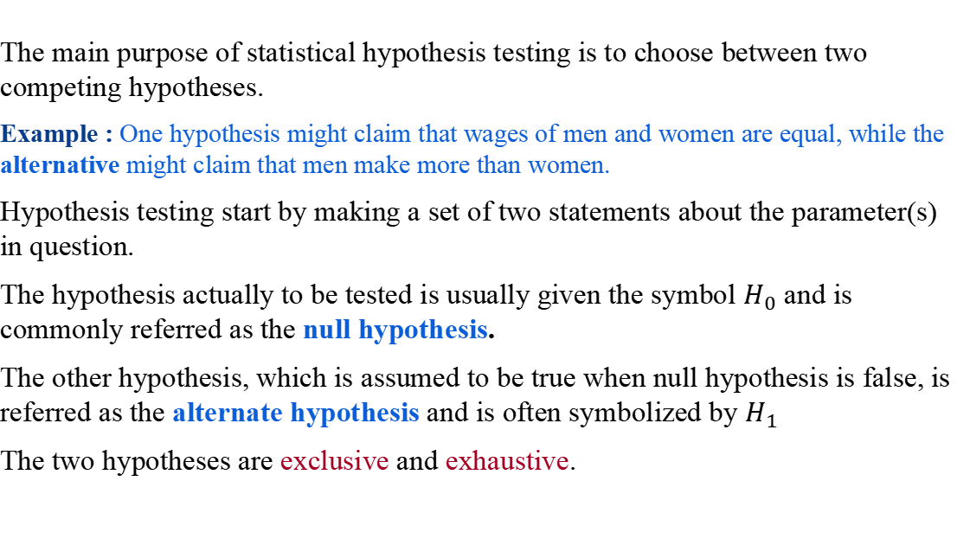
The Hypotheses
The main purpose of statistical hypothesis testing is to choose between two competing hypotheses.
Example : One hypothesis might claim that wages of men and women are equal, while the alternative might claim that men make more than women.
Hypothesis testing start by making a set of two statements about the parameter(s) in question.
The hypothesis actually to be tested is usually given the symbol $H_{0}$ and is commonly referred as the null hypothesis.
The other hypothesis, which is assumed to be true when null hypothesis is false, is referred as the alternate hypothesis and is often symbolized by $H_{1}$
The two hypotheses are exclusive and exhaustive.

Slide 47
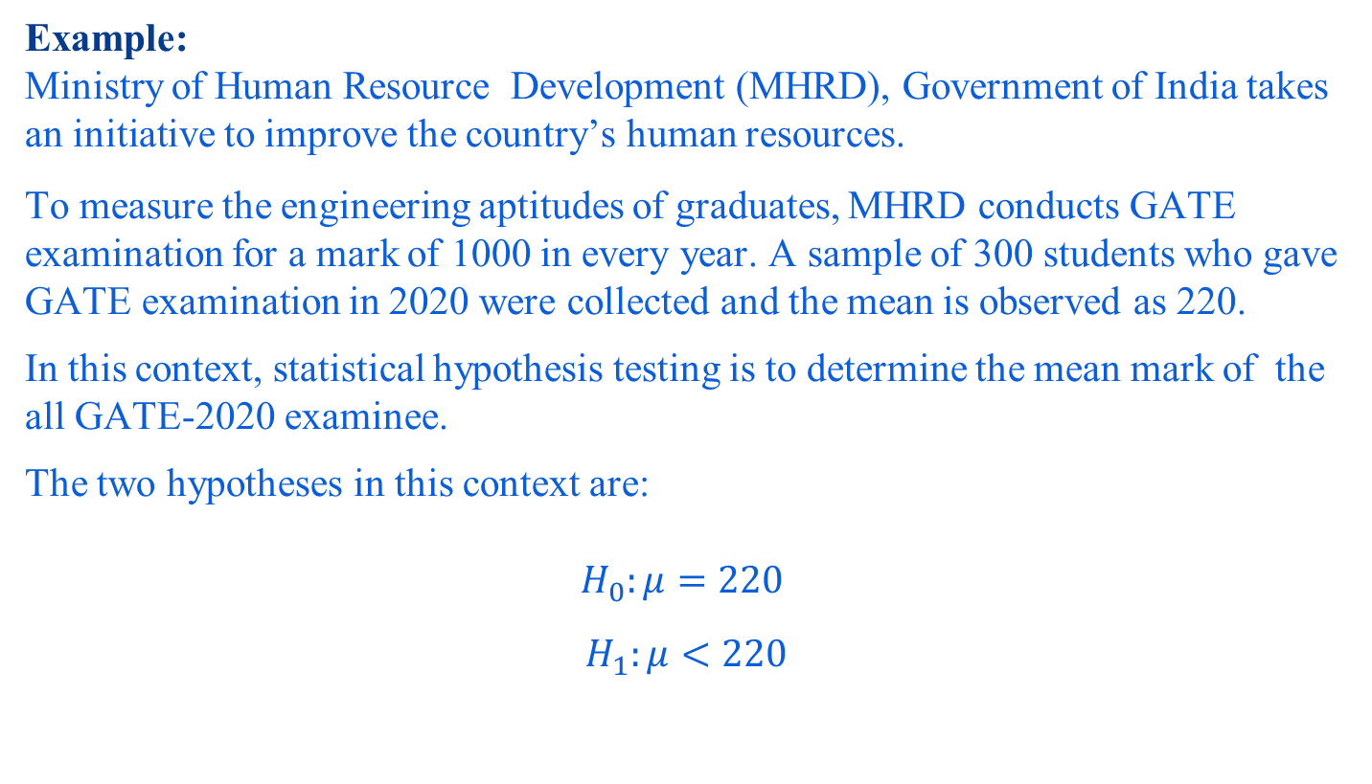
The Hypotheses
Example:
Ministry of Human Resource Development (MHRD), Government of India takes an initiative to improve the country’s human resources.
To measure the engineering aptitudes of graduates, MHRD conducts GATE examination for a mark of 1000 in every year. A sample of 300 students who gave GATE examination in 2020 were collected and the mean is observed as 220.
In this context, statistical hypothesis testing is to determine the mean mark of the all GATE-2020 examinee.
The two hypotheses in this context are:
$$H_{0}:μ=220$$
$$H_{1}:μ<220$$

Slide 48
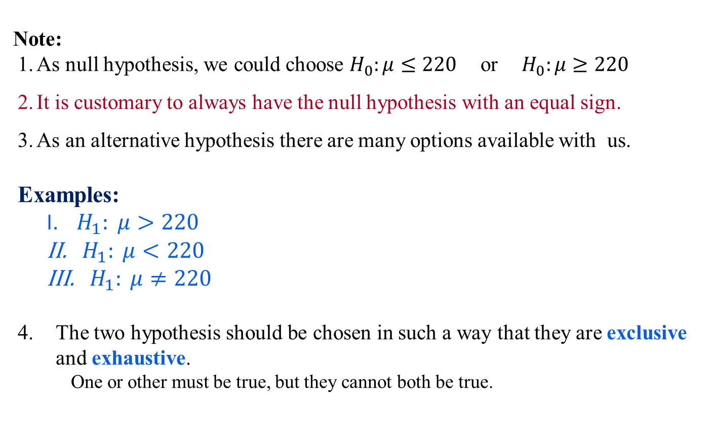
The Hypotheses
Note:
As null hypothesis, we could choose $H_{0}:μ≤220$or${ H}_{0}:μ≥220$
It is customary to always have the null hypothesis with an equal sign.
As an alternative hypothesis there are many options available with us.
Examples:
$H_{1}: μ>220$
${ H}_{1}: μ<220$
${ H}_{1}: μ≠220$
The two hypothesis should be chosen in such a way that they are exclusive and exhaustive.
One or other must be true, but they cannot both be true.

Slide 49
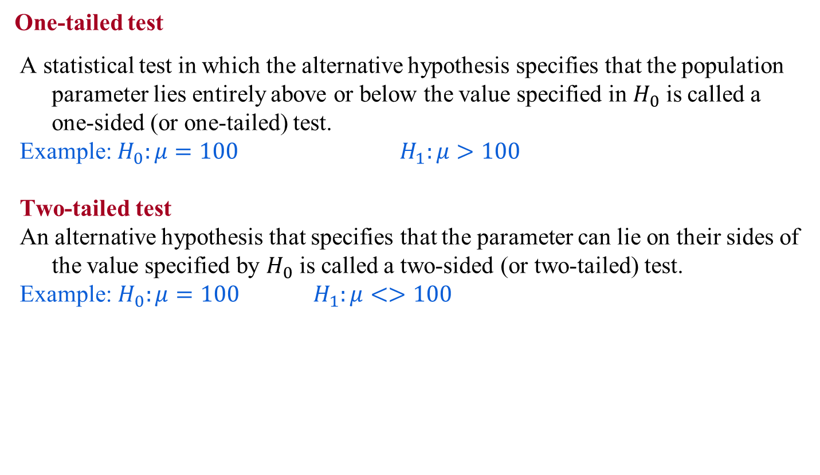
The Hypotheses
One-tailed test
A statistical test in which the alternative hypothesis specifies that the population parameter lies entirely above or below the value specified in $H_{0}$ is called a one-sided (or one-tailed) test.
Example: $H_{0}:μ=100$ $H_{1}:μ>100$
Two-tailed test
An alternative hypothesis that specifies that the parameter can lie on their sides of the value specified by $H_{0}$ is called a two-sided (or two-tailed) test.
Example:$H_{0}:μ=100 H_{1}:μ<>100$

Slide 50
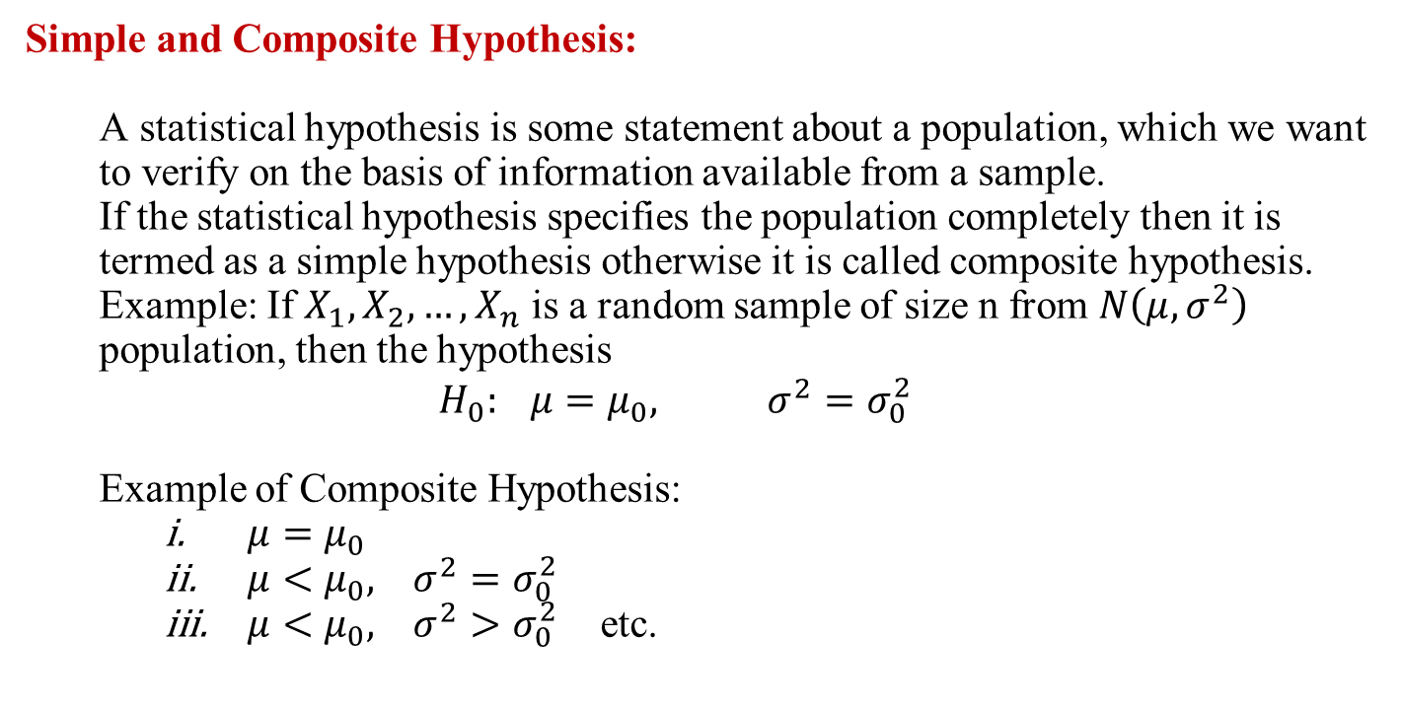
The Hypotheses
Simple and Composite Hypothesis:
A statistical hypothesis is some statement about a population, which we want to verify on the basis of information available from a sample.
If the statistical hypothesis specifies the population completely then it is termed as a simple hypothesis otherwise it is called composite hypothesis.
Example: If $X_{1},X_{2}, …,X_{n}$ is a random sample of size n from $N\left(μ,σ^{2}\right)$ population, then the hypothesis
$$H_{0}: μ=μ_{0}, σ^{2}=σ_{0}^{2}$$
Example of Composite Hypothesis:
$μ=μ_{0}$
$μ<μ_{0}, σ^{2}=σ_{0}^{2}$
$μ<μ_{0}, σ^{2}>σ_{0}^{2}$ etc.

Slide 51
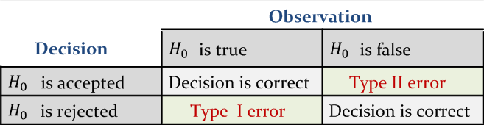
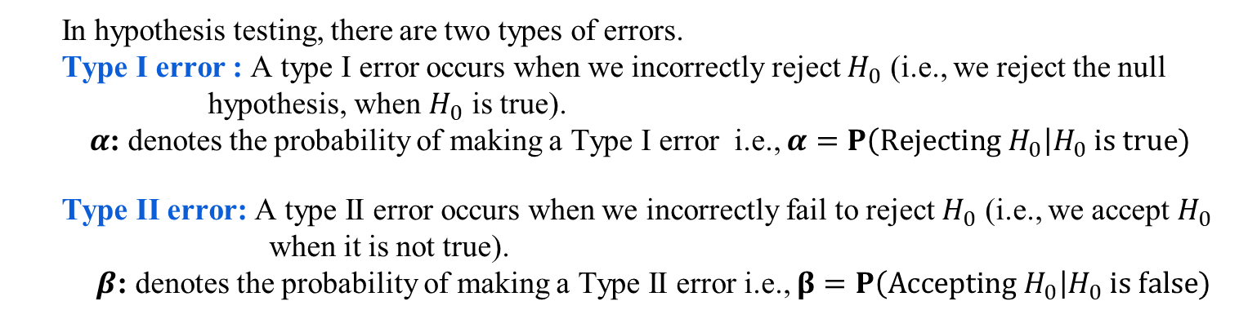
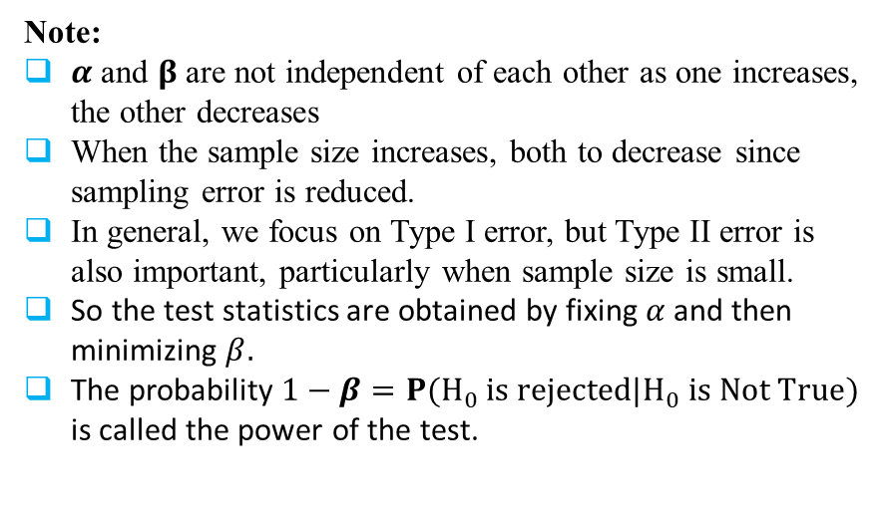
Errors in Hypothesis Testing
In hypothesis testing, there are two types of errors.
Type I error : A type I error occurs when we incorrectly reject $H_{0}$ (i.e., we reject the null hypothesis, when $H_{0}$ is true).
$α$: denotes the probability of making a Type I error i.e., $α=P\left(Rejecting H_{0}\right|H_{0} is true)$
Type II error: A type II error occurs when we incorrectly fail to reject $H_{0}$ (i.e., we accept $H_{0}$ when it is not true).
$β$: denotes the probability of making a Type II error i.e., $β=P\left(Accepting H_{0}\right|H_{0} is false)$
Note:
$α$ and $β$ are not independent of each other as one increases, the other decreases
When the sample size increases, both to decrease since sampling error is reduced.
In general, we focus on Type I error, but Type II error is also important, particularly when sample size is small.
So the test statistics are obtained by fixing $α$and then minimizing $β.$
The probability $1−β=P(H_{0} is rejected|H_{0} is Not True)$ is called the power of the test.

Slide 52
Hypothesis Testing Strategies
The hypothesis testing determines the validity of an assumption (technically described as null hypothesis), with a view to choose between two conflicting hypothesis about the value of a population parameter.
There are two types of tests of hypotheses
Non-parametric tests (also called distribution-free test of hypotheses)
Parametric tests (also called standard test of hypotheses).

Slide 53
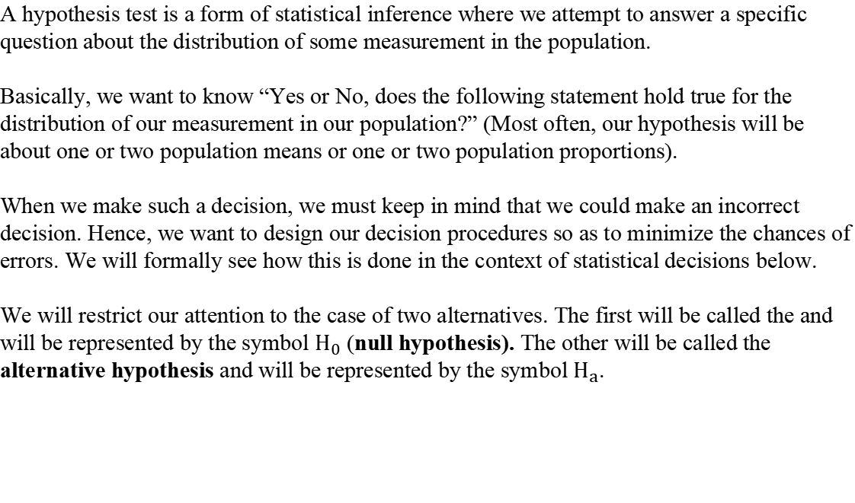
Hypothesis Tests…
A hypothesis test is a form of statistical inference where we attempt to answer a specific question about the distribution of some measurement in the population.
Basically, we want to know “Yes or No, does the following statement hold true for the distribution of our measurement in our population?” (Most often, our hypothesis will be about one or two population means or one or two population proportions).
When we make such a decision, we must keep in mind that we could make an incorrect decision. Hence, we want to design our decision procedures so as to minimize the chances of errors. We will formally see how this is done in the context of statistical decisions below.
We will restrict our attention to the case of two alternatives. The first will be called the and will be represented by the symbol $H_{0}$ (null hypothesis). The other will be called the alternative hypothesis and will be represented by the symbol $H_{a}$.

Slide 54
Hypothesis Tests…
The alternative hypothesis is usually some positive statement about the experiment being analyzed and is often called the “research hypothesis” because it is what the researcher is trying to show in the experiment.
The null hypothesis is often a representation of the status quo or other representation of lack of positive results in the experiment. Hence the aspect of “null” about the null hypothesis.
Example: In an analgesic drug experiment the alternate hypothesis might be that the new drug relieves pain faster than the old drug. The null hypothesis would then be that the new drug does not relieve pain faster.
Example: In a teaching experiment, the alternative hypothesis might be that the new method results in higher scores than the old method. The null hypothesis would be that this is not so.

Slide 55
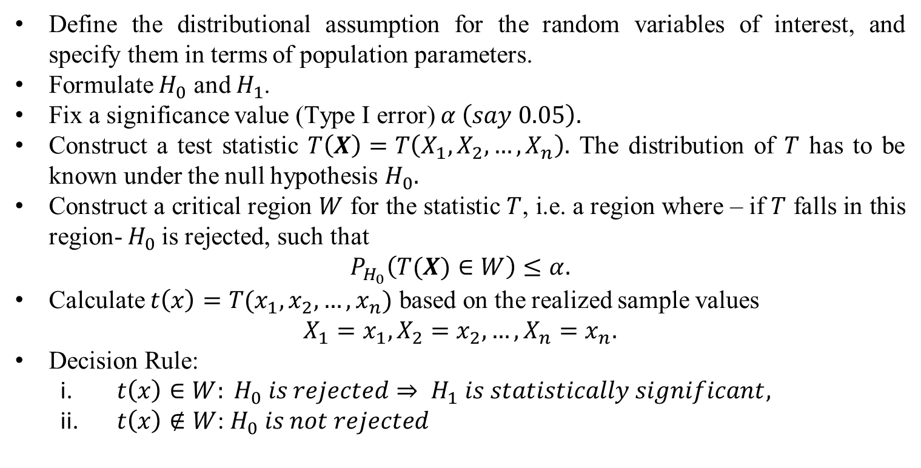
How to Conduct a Statistical Test
Define the distributional assumption for the random variables of interest, and specify them in terms of population parameters.
Formulate $H_{0}$ and $H_{1}$.
Fix a significance value (Type I error) $α \left(say 0.05\right).$
Construct a test statistic $T\left(X\right)=T\left(X_{1},X_{2}, …,X_{n}\right).$ The distribution of $T$ has to be known under the null hypothesis $H_{0}.$
Construct a critical region $W$ for the statistic $T$, i.e. a region where – if $T$ falls in this region- $H_{0}$is rejected, such that
$$P_{H_{0}}\left(T(X)∈W\right)≤α.$$
Calculate $t\left(x\right)=T(x_{1},x_{2},…,x_{n})$ based on the realized sample values
$$X_{1}=x_{1},X_{2}=x_{2}, …,X_{n}=x_{n}.$$
Decision Rule:
$t\left(x\right)∈W: H_{0} is rejected⇒ H_{1} is statistically significant,$
$t\left(x\right)∉W$: $H_{0} is not rejected$

Slide 56
P-values…
P-value is a measure of consistency between the null hypothesis and the observed data.
Hence, we will be more inclined to believe the alternative hypothesis when the P-value is small and less likely to believe the alternative hypothesis when the P-value is not so small.
We make a rule for statistical decisions as follows. We establish a cut-off value called the level of significance.
Then we reject the null hypothesis in favor of the alternative hypothesis when the P-value is less than the level of significance.
If the P-value is not less than the level of significance, then we fail to reject the null hypothesis in favor of the alternative hypothesis.

Slide 57
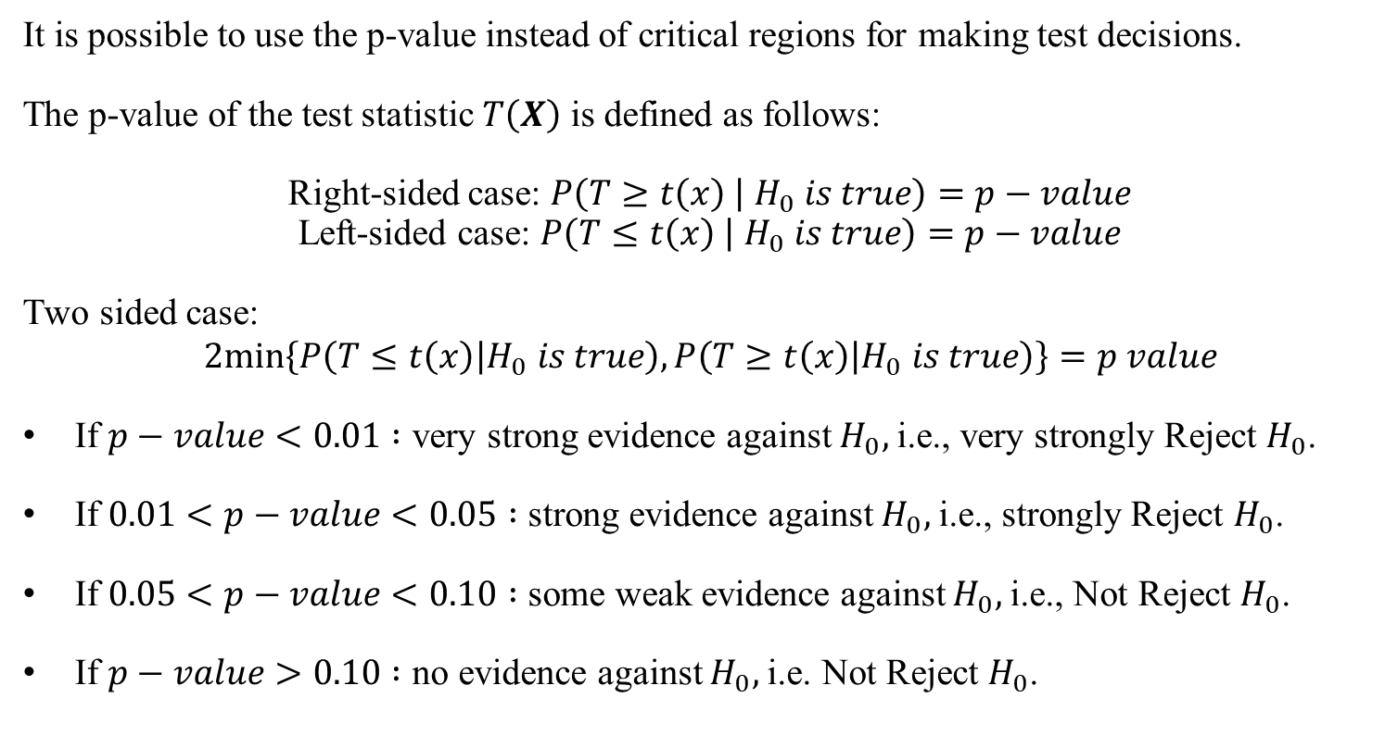
Test Decision Using the p-value
It is possible to use the p-value instead of critical regions for making test decisions.
The p-value of the test statistic $T\left(X\right)$ is defined as follows:
Right-sided case: $P\left(T≥t\left(x\right) | H_{0} is true\right)=p−value$
Left-sided case: $P\left(T≤t\left(x\right) | { H}_{0} is true\right)=p−value$
Two sided case:
$$2min\left\{P\left(T≤t\left(x\right) | H_{0} is true\right),P\left(T≥t\left(x\right) | H_{0} is true\right)\right\}=p value$$
If $p−value<0.01 :$ very strong evidence against $H_{0},$i.e., very strongly Reject $H_{0}$.
If $0.01<p−value<0.05 :$ strong evidence against $H_{0},$i.e., strongly Reject $H_{0}$.
If $0.05<p−value<0.10 :$ some weak evidence against $H_{0},$i.e., Not Reject $H_{0}$.
If $p−value>0.10 :$ no evidence against $H_{0},$i.e. Not Reject $H_{0}$.

Slide 58
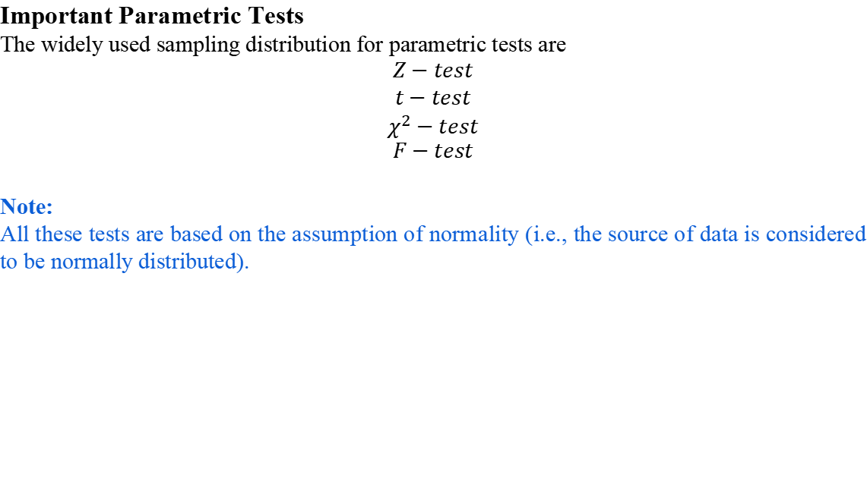
Parametric Tests
Important Parametric Tests
The widely used sampling distribution for parametric tests are
$$Z−test$$
$$t−test$$
$$χ^{2}−test$$
$$F−test$$
Note:
All these tests are based on the assumption of normality (i.e., the source of data is considered to be normally distributed).

Slide 59
Parametric Tests : Applications
Usually assume certain properties of the population from which we draw samples.
Observation come from a normal population
Sample size is small
Population parameters like mean, variance, etc. are hold good.
Requires measurement equivalent to interval scaled data.

Slide 60
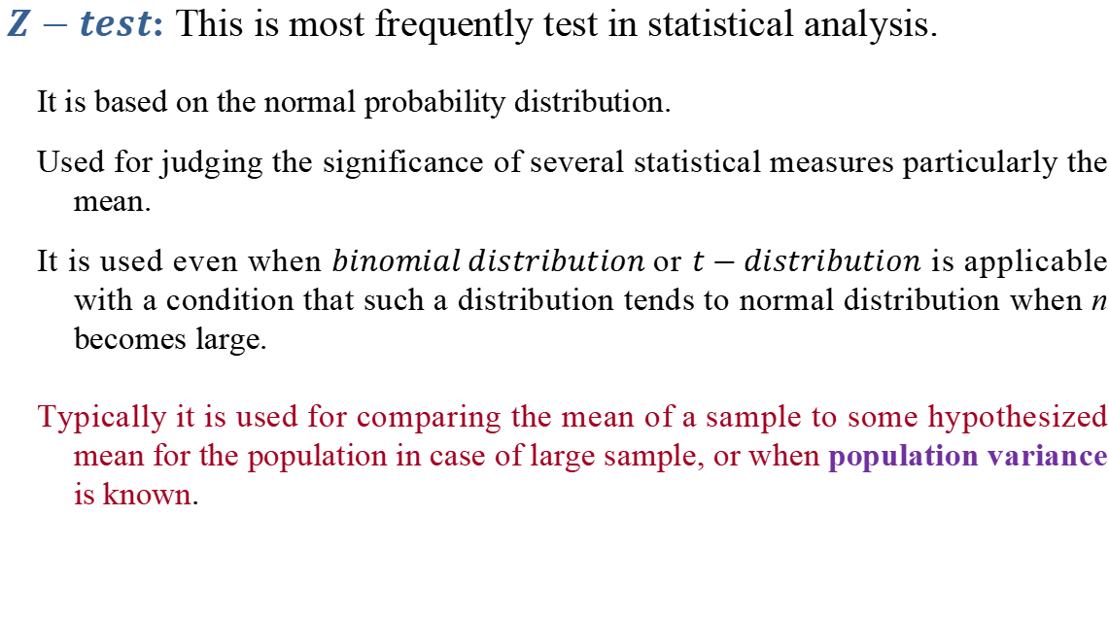
Parametric Tests : Z-test
$Z−test$: This is most frequently test in statistical analysis.
It is based on the normal probability distribution.
Used for judging the significance of several statistical measures particularly the mean.
It is used even when $binomial distribution$or $t−distribution$ is applicable with a condition that such a distribution tends to normal distribution when n becomes large.
Typically it is used for comparing the mean of a sample to some hypothesized mean for the population in case of large sample, or when population variance is known.

Slide 61
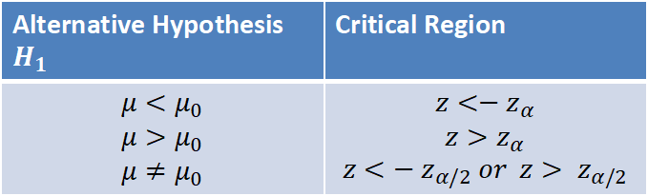
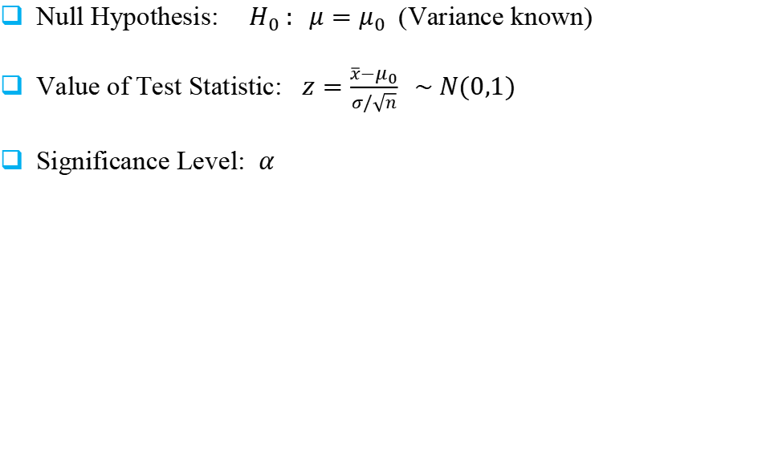
Single Sample: Test Concerning a Single Mean
Null Hypothesis: ${ H}_{0} : μ=μ_{0}$ (Variance known)
Value of Test Statistic: $z=\frac{\overline{x}−μ_{0}}{σ/\sqrt{n}} \sim N(0,1)$
Significance Level: $α$
Alternative Hypothesis $H_{1}$ | Critical Region
$$μ<μ_{0}$$ $$μ>μ_{0}$$ $$μ≠μ_{0}$$ | $$z<−z_{α}$$ $$z>z_{α}$$ $$z<{− z}_{α/2} or z> z_{α/2}$$

Slide 62
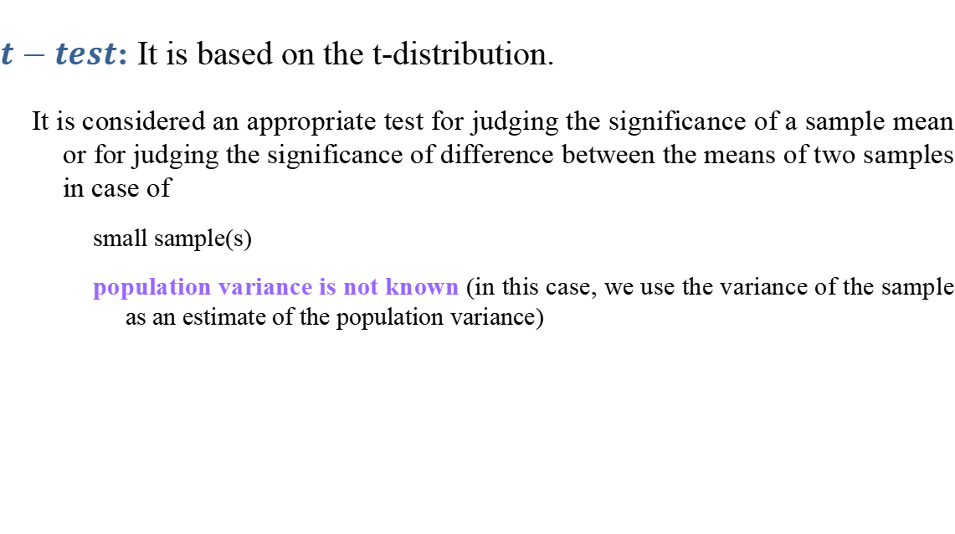
Parametric Tests : t-test
$t−test$: It is based on the t-distribution.
It is considered an appropriate test for judging the significance of a sample mean or for judging the significance of difference between the means of two samples in case of
small sample(s)
population variance is not known (in this case, we use the variance of the sample as an estimate of the population variance)

Slide 63
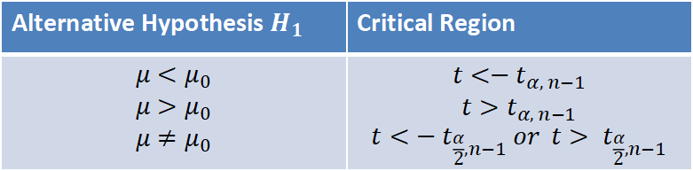
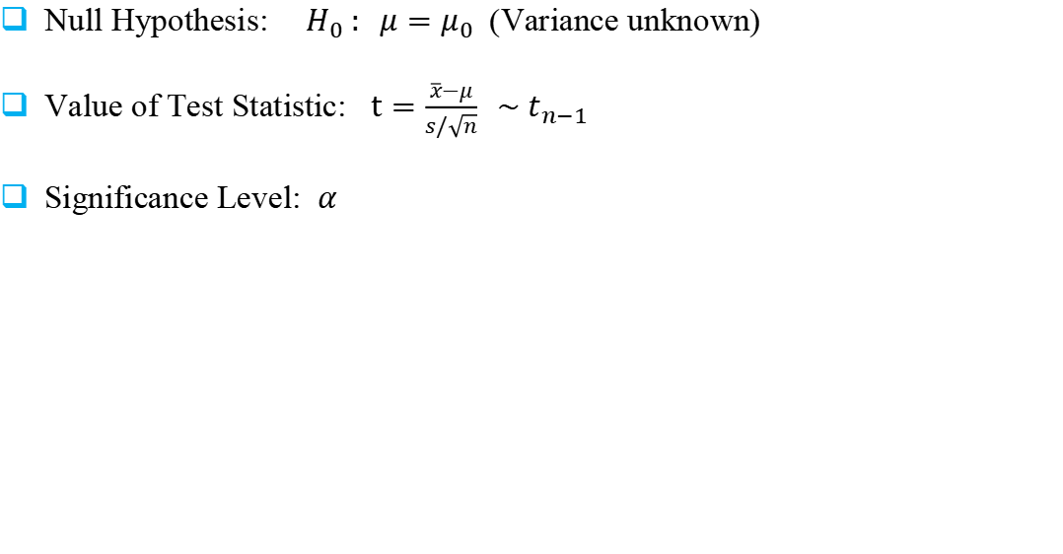
Single Sample: Test Concerning a Single Mean
Null Hypothesis: ${ H}_{0} : μ=μ_{0}$ (Variance unknown)
Value of Test Statistic: $t=\frac{\overline{x}−μ}{s/\sqrt{n}} \sim t_{n−1}$
Significance Level: $α$
Alternative Hypothesis $H_{1}$ | Critical Region
$$μ<μ_{0}$$ $$μ>μ_{0}$$ $$μ≠μ_{0}$$ | $$t<−t_{α, n−1}$$ $$t>t_{α, n−1}$$ $$t<{− t}_{\frac{α}{2},n−1} or t> t_{\frac{α}{2},n−1}$$

Slide 64
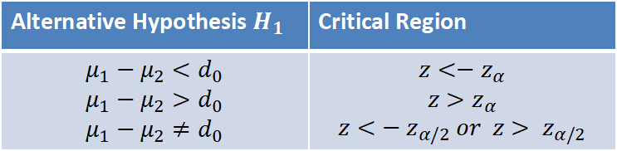
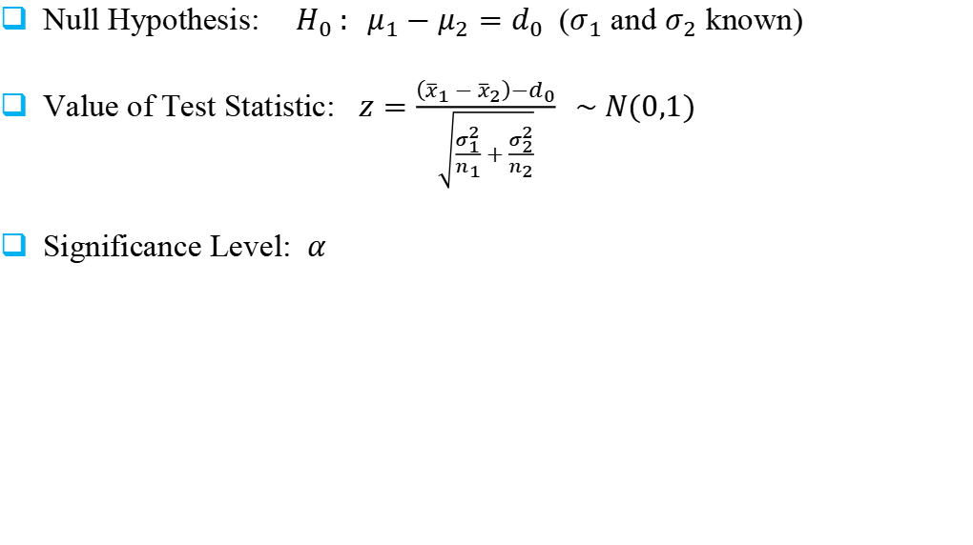
Two Sample: Test on Two Mean
Null Hypothesis: ${ H}_{0} : μ_{1}−μ_{2}=d_{0}$ ($σ_{1}$ and $σ_{2}$ known)
Value of Test Statistic: $z=\frac{\left({\overline{x}}_{1}−{\overline{x}}_{2}\right)−d_{0}}{\sqrt{\frac{σ_{1}^{2}}{n_{1}}+\frac{σ_{2}^{2}}{n_{2}}}} \sim N(0,1)$
Significance Level: $α$
Alternative Hypothesis $H_{1}$ | Critical Region
$$μ_{1}−μ_{2}<d_{0}$$ $$μ_{1}−μ_{2}>d_{0}$$ $$μ_{1}−μ_{2}≠d_{0}$$ | $$z<−z_{α}$$ $$z>z_{α}$$ $$z<{− z}_{α/2} or z> z_{α/2}$$

Slide 65
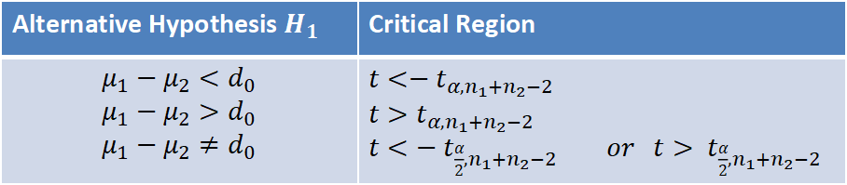
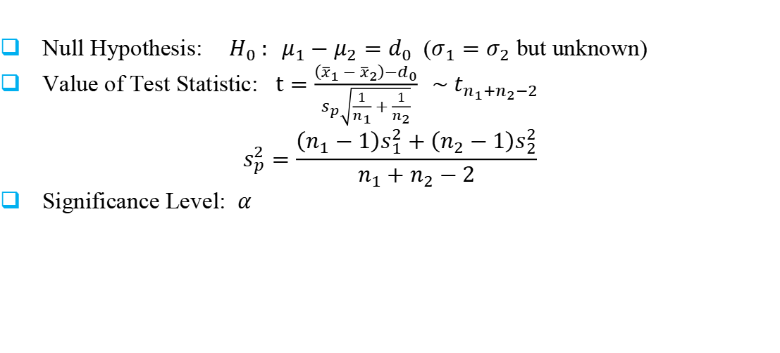
Two Sample: Test on Two Mean
Null Hypothesis: ${ H}_{0} : μ_{1}−μ_{2}=d_{0}$ ($σ_{1}=$ $σ_{2}$ but unknown)
Value of Test Statistic: $t=\frac{\left({\overline{x}}_{1}−{\overline{x}}_{2}\right)−d_{0}}{s_{p}\sqrt{\frac{1}{n_{1}}+\frac{1}{n_{2}}}} \sim t_{n_{1}+n_{2}−2}$
$$s_{p}^{2}=\frac{\left(n_{1}−1\right)s_{1}^{2}+\left(n_{2}−1\right)s_{2}^{2}}{n_{1}+n_{2}−2}$$
Significance Level: $α$
Alternative Hypothesis $H_{1}$ | Critical Region
$$μ_{1}−μ_{2}<d_{0}$$ $$μ_{1}−μ_{2}>d_{0}$$ $$μ_{1}−μ_{2}≠d_{0}$$ | $$t<−t_{α,n_{1}+n_{2}−2}$$ $$t>t_{α,n_{1}+n_{2}−2}$$ $t<{− t}_{\frac{α}{2},n_{1}+n_{2}−2} or$ $t> t_{\frac{α}{2},n_{1}+n_{2}−2}$

Slide 66

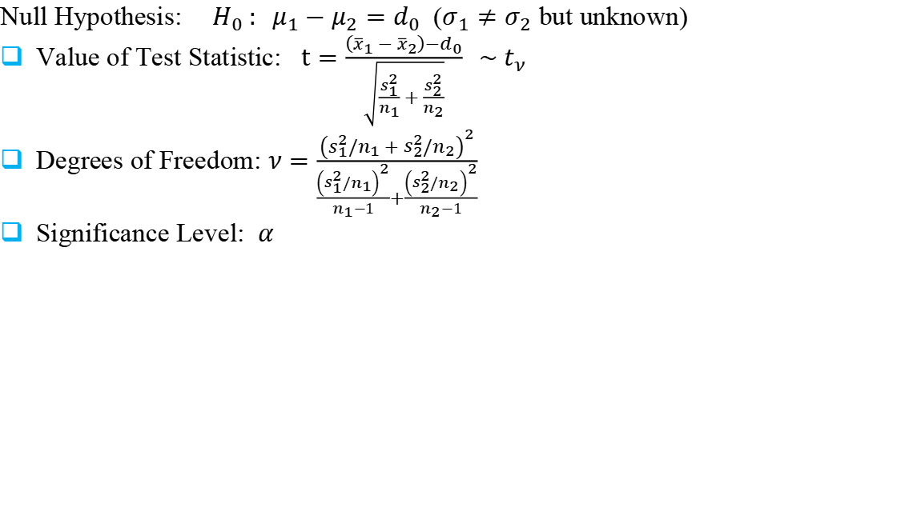
Two Sample: Test on Two Mean
Null Hypothesis: ${ H}_{0} : μ_{1}−μ_{2}=d_{0}$ ($σ_{1}≠$ $σ_{2}$ but unknown)
Value of Test Statistic: $t=\frac{\left({\overline{x}}_{1}−{\overline{x}}_{2}\right)−d_{0}}{\sqrt{\frac{s_{1}^{2}}{n_{1}}+\frac{s_{2}^{2}}{n_{2}}}} \sim t_{ν}$
Degrees of Freedom: $ν=\frac{{\left(s_{1}^{2}/n_{1}+s_{2}^{2}/n_{2}\right)}^{2}}{\frac{{\left(s_{1}^{2}/n_{1}\right)}^{2}}{n_{1}−1}+\frac{{\left(s_{2}^{2}/n_{2}\right)}^{2}}{n_{2}−1}}$
Significance Level: $α$
Alternative Hypothesis $H_{1}$ | Critical Region
$$μ_{1}−μ_{2}<d_{0}$$ $$μ_{1}−μ_{2}>d_{0}$$ $$μ_{1}−μ_{2}≠d_{0}$$ | $$t<−t_{α, ν }$$ $$t>t_{α, ν }$$ $$t<{− t}_{\frac{α}{2}, ν } or t> t_{\frac{α}{2}, ν }$$

Slide 67

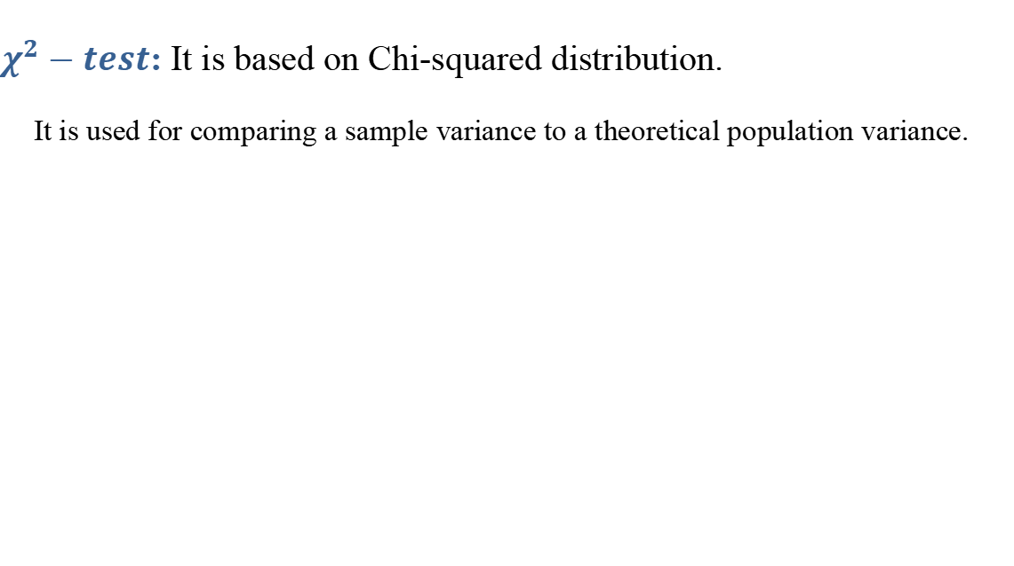

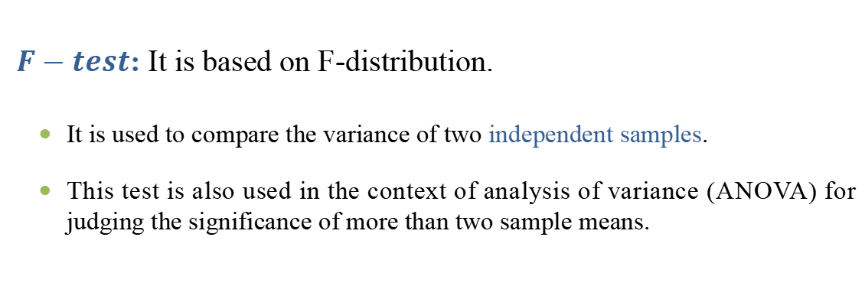
Parametric Tests : $χ^{2}$-test
$χ^{2}−test$: It is based on Chi-squared distribution.
It is used for comparing a sample variance to a theoretical population variance.
Parametric Tests : $F$-test
$F−test$: It is based on F-distribution.
It is used to compare the variance of two independent samples.
This test is also used in the context of analysis of variance (ANOVA) for judging the significance of more than two sample means.

Slide 68
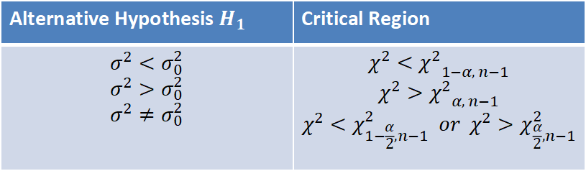
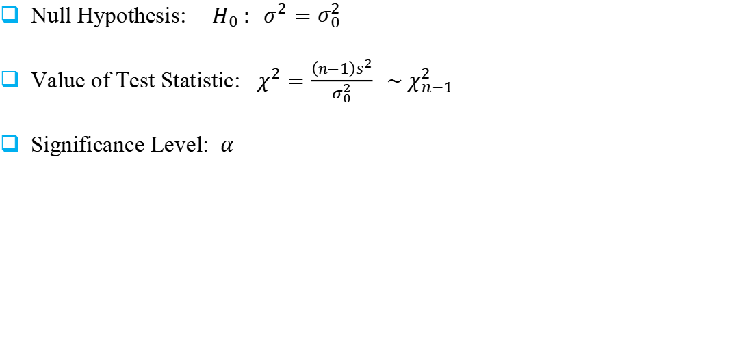
Single Sample: Test Concerning Variance
Null Hypothesis: ${ H}_{0} : σ^{2}=σ_{0}^{2}$
Value of Test Statistic: $χ^{2}=\frac{\left(n−1\right)s^{2}}{σ_{0}^{2}} \sim χ_{n−1}^{2}$
Significance Level: $α$
Alternative Hypothesis $H_{1}$ | Critical Region
$$σ^{2}<σ_{0}^{2}$$ $$σ^{2}>σ_{0}^{2}$$ $$σ^{2}≠σ_{0}^{2}$$ | $$χ^{2}<{χ^{2}}_{1−α, n−1}$$ $$χ^{2}>{χ^{2}}_{α, n−1}$$ $$χ^{2}<χ_{1−\frac{α}{2},n−1}^{2} or χ^{2}>χ_{\frac{α}{2},n−1}^{2}$$

Slide 69
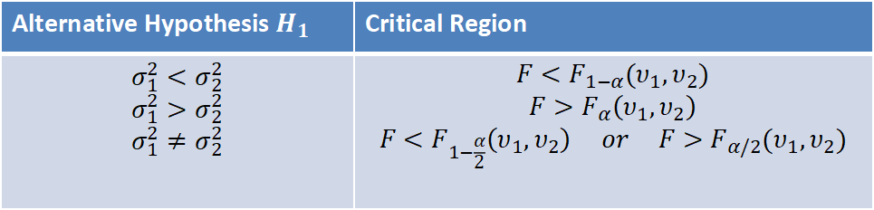
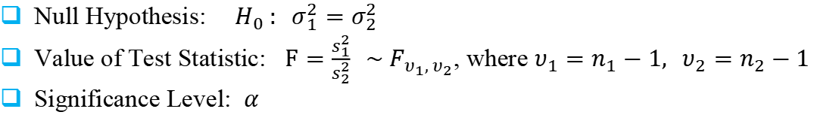
Two Sample: Test Concerning Variance
Null Hypothesis: ${ H}_{0} : σ_{1}^{2}=σ_{2}^{2}$
Value of Test Statistic: $F=\frac{s_{1}^{2}}{s_{2}^{2}} \sim F_{υ_{1}, υ_{2}}$, where $υ_{1}=n_{1}−1, υ_{2}=n_{2}−1$
Significance Level: $α$
Alternative Hypothesis $H_{1}$ | Critical Region
$$σ_{1}^{2}<σ_{2}^{2}$$ $$σ_{1}^{2}>σ_{2}^{2}$$ $$σ_{1}^{2}≠σ_{2}^{2}$$ | $$F<F_{1−α}(υ_{1},υ_{2})$$ $$F>F_{α}\left(υ_{1},υ_{2}\right)$$ $$F<F_{1−\frac{α}{2}}\left(υ_{1},υ_{2}\right) or F>F_{α/2}(υ_{1},υ_{2})$$

Slide 70

Case Study 1: Coffee Sale
A coffee vendor nearby Yesvantpur Junction Railway Station has been having average sales of 500 cups per day. Because of the development of a bus stand nearby, it expects to increase its sales. During the first 12 days, after the inauguration of the bus stand, the daily sales were as under:
550 570 490 615 505 580 570 460 600 580 530 526
On the basis of this sample information, can we conclude that the sales of coffee have increased?
Consider 5% level of confidence.

Slide 71
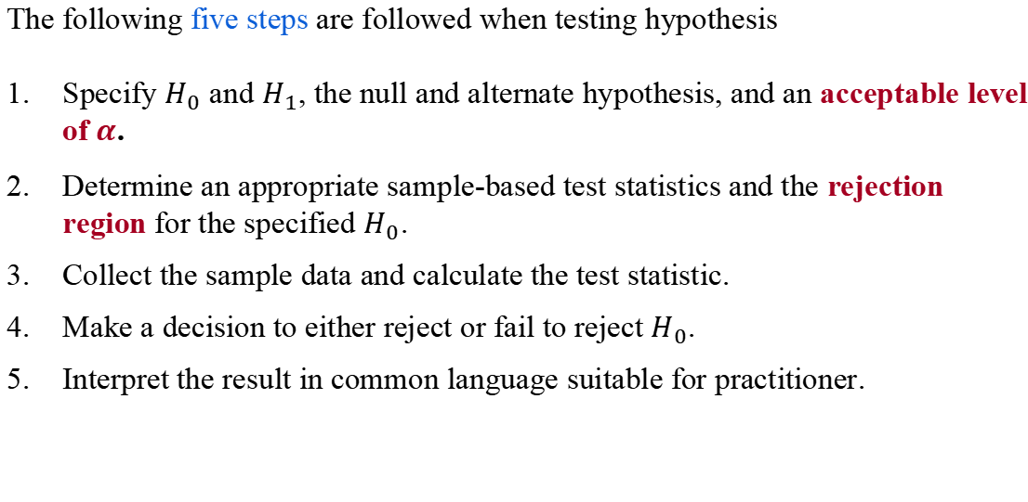
Hypothesis Testing : 5 Steps
The following five steps are followed when testing hypothesis
Specify $H_{0}$ and $H_{1}$, the null and alternate hypothesis, and an acceptable level of $α$.
Determine an appropriate sample-based test statistics and the rejection region for the specified $H_{0}$.
Collect the sample data and calculate the test statistic.
Make a decision to either reject or fail to reject $H_{0}$.
Interpret the result in common language suitable for practitioner.

Slide 72
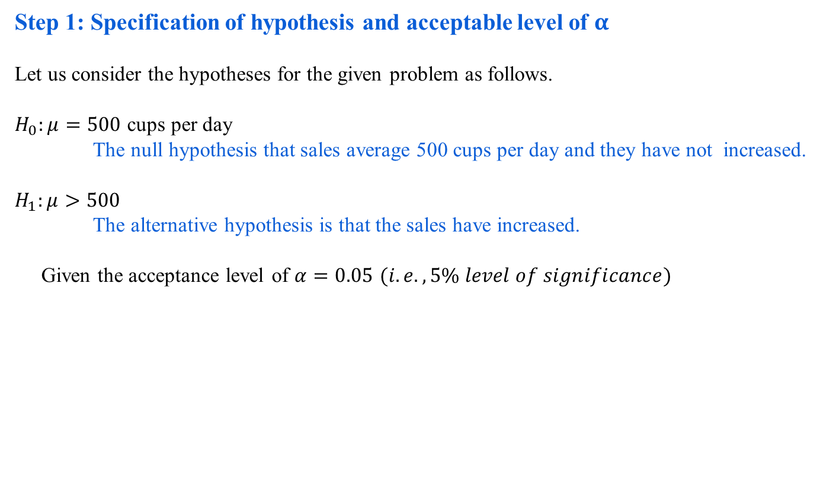
Case Study 1: Step 1
Step 1: Specification of hypothesis and acceptable level of $α$
Let us consider the hypotheses for the given problem as follows.
$H_{0}:μ=500$ cups per day
The null hypothesis that sales average 500 cups per day and they have not increased.
$$H_{1}:μ>500$$
The alternative hypothesis is that the sales have increased.
Given the acceptance level of $α=0.05$ $(i.e., 5\% level of significance)$

Slide 73
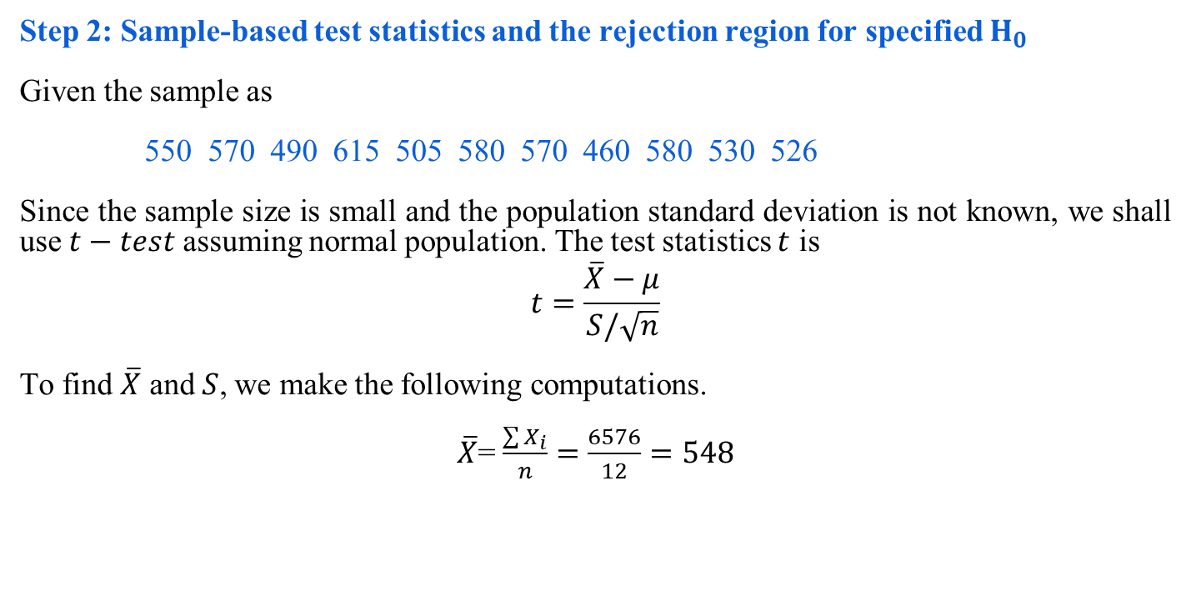
Case Study 1: Step 2
Step 2: Sample-based test statistics and the rejection region for specified $H_{0}$
Given the sample as
550 570 490 615 505 580 570 460 580 530 526
Since the sample size is small and the population standard deviation is not known, we shall use $t−test$ assuming normal population. The test statistics $t$ is
$$t=\frac{\overline{X}−μ}{S/\sqrt{n}}$$
To find $\overline{X}$ and $S$, we make the following computations.
$\overline{X}$=$\frac{\sum{X_{i}}}{n}=\frac{6576}{12}=548$

Slide 74
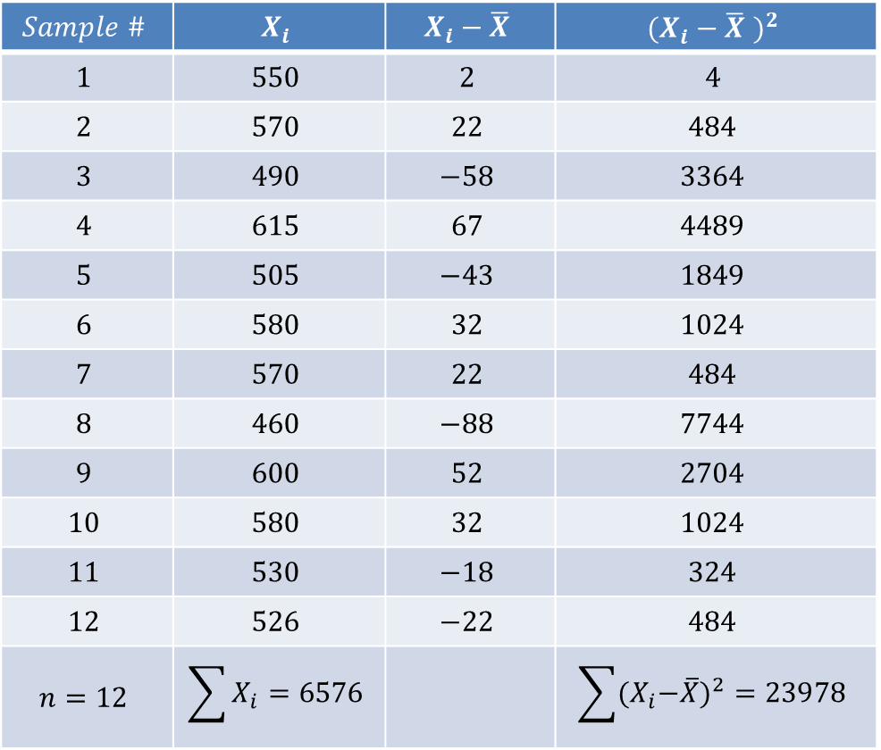
Case Study 1: Step 2
$$Sample \#$$ | $$X_{i}$$ | $$X_{i}−\overline{X}$$ | $${(X_{i}−\overline{X} )}^{2}$$
$$1$$ | $$550$$ | $$2$$ | $$4$$
$$2$$ | $$570$$ | $$22$$ | $$484$$
$$3$$ | $$490$$ | $$−58$$ | $$3364$$
$$4$$ | $$615$$ | $$67$$ | $$4489$$
$$5$$ | $$505$$ | $$−43$$ | $$1849$$
$$6$$ | $$580$$ | $$32$$ | $$1024$$
$$7$$ | $$570$$ | $$22$$ | $$484$$
$$8$$ | $$460$$ | $$−88$$ | $$7744$$
$$9$$ | $$600$$ | $$52$$ | $$2704$$
$$10$$ | $$580$$ | $$32$$ | $$1024$$
$$11$$ | $$530$$ | $$−18$$ | $$324$$
$$12$$ | $$526$$ | $$−22$$ | $$484$$
$$n=12$$ | $$\sum{X_{i}=6576}$$ |  | $$\sum{{{(X}_{i}−\overline{X})}^{2}=23978}$$

Slide 75
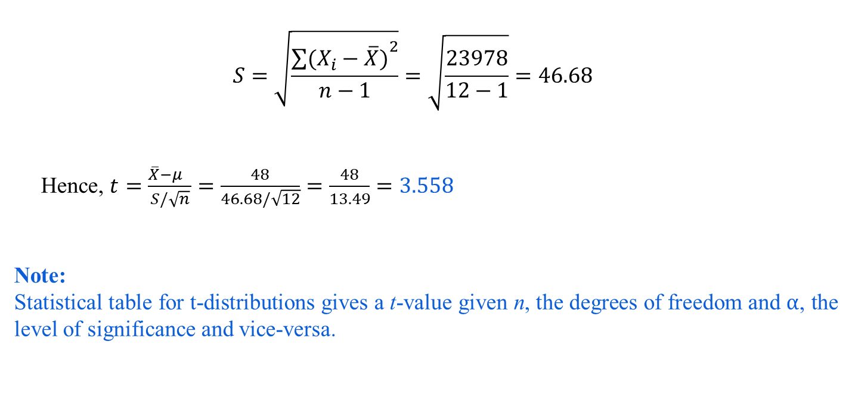
Case Study 1: Step 2
$$S=\sqrt{\frac{{\sum{(X_{i}−\overline{X})}}^{2}}{n−1}}=\sqrt{\frac{23978}{12−1}}=46.68$$
Hence, $t=\frac{\overline{X}−μ }{S/\sqrt{n}}=\frac{48}{46.68/\sqrt{12}}=\frac{48}{13.49}=3.558$
Note:
Statistical table for t-distributions gives a t-value given n, the degrees of freedom and $α$, the level of significance and vice-versa.

Slide 76

Case Study 1: Step 3
Step 3: Collect the sample data and calculate the test statistics
$$Degree of freedom=n−1=12−1=11$$
As $H_{1}$ is one-tailed, we shall determine the rejection region applying one-tailed in the right tail because $H_{1}$ is more than type ) at $5\%$ level of significance.
Using table of $t−distribution$ for 11 degrees of freedom and with $5\%$ level of significance,
$$R:t>1.796$$

Slide 77

Case Study 1: Step 4
Step 4: Make a decision to either reject or fail to reject H₀
The observed value of $t=3.558$ which is in the rejection region and thus $H_{0}$ is rejected at $5\%$ level of significance.
Case Study 1: Step 5
Step 5: Final comment and interpret the result
We can conclude that the sample data indicate that coffee sales have increased.

Slide 78
Hypothesis Testing : Non-Parametric Test
Non-Parametric tests
Does not under any assumption
Assumes only nominal or ordinal data
Note: Non-parametric tests need entire population (or very large sample size)

Slide 79

Analysis of Variance (ANOVA)
ANOVA is a statistical technique
It is similar in application to techniques such as t-test, Z-test and χ²-test in that it is used to compare means and the relative variance between them.
Why not use t-test, Z-test and χ²-test ?
Why analysis of variance for comparing means?
t-test is used to:
To infer mean of a single population
t-test can be used to compare two populations
However, t-test is not useful to compare mean of more than two populations.

Slide 80

Extending the two population procedure
Construct pairwise comparison on all means.
For 5 populations $→$10 possible pairs.
Considering $α = 0.05$, probability of correctly failing to reject the null hypothesis for all 10 tests is $(0.95)10$, assuming that the tests are independent
Thus the true value of α for this set of comparison is 0.4, instead of .05
It inflates the Type I error.

Slide 81
Extending the two population procedure
Statistical Inference I
A teacher is interested in a comparison of the average percentage marks obtained in the examinations of five different subjects and has available the marks of eight students who all completed each examination.
What is the number of populations?
How many samples? What are there sizes? Are each samples independent to each other?
Subject 1 | Subject 2 | Subject 3 | Subject 4 | Subject 5

Slide 82
Some Terminologies
Factor
A characteristic under consideration, thought to influence the measured observations
Level (also called treatment)
A value of the factor
Typical data for a Single-Factor Experiment
Level | Observations |  |  |  | Total | Mean
1 | y₁₁ | y₁₂ | … | y_{1n1}
2 | y₂₁ | y₂₂ | … | y_{2n2}
… | … | … | … | …
… | … | … | … | …
… | … | … | … | …
k | y_{k1} | y_{k2} | … | y_{knk}

Slide 83

One-way ANOVA
The purpose of the procedure is to compare sample means of $k$ populations.
In general, One-way ANOVA technique can be used to study the effect of
$k (> 2)$levels of a single factor.
To determine if different levels of the factor affect measured observations differently, the following hypotheses are tested.
$H_{0}: μ_{i}=μ$ all $i=1,2,…,k$
$H_{1}: μ_{i}≠μ$ some $i=1,2,…,k$
That is, at least one equality is not satisfied
where $μ_{i}$ is the population mean for a level $i$.

Slide 84

Assumptions
When applying one-way analysis of variance, there are three key assumptions that should be satisfied as follows.
The observations are obtained independently and randomly from the populations defined by the factor levels.
The population at each factor level is (approximately) normally distributed.
These normal populations have a common variance, $σ^{2}$.
Thus, for factor level $i$, the population is assumed to have a distribution which is $N(μ_{i},σ^{2})$.

Slide 85

Heuristic Justification of ANOVA
If the null hypothesis is true, that is, each of the µ_{i} has the same value, say, µ, then the distribution of each of the k sample means, $\overline{y_{i.}}$ will have mean µ and variance $σ^{2}$/n .
It then follows that, if we calculate a variance using the sample means as observations,
${\hat{σ}}_{B}^{2}= \sum{\left({\overline{y}}_{i.}−{\overline{y}}_{..}\right)2/(k−1)}$
Then the quantity is an estimate of $σ^{2}$/n .
Hence, n${\hat{σ}}_{B}^{2}$ is an estimate of $σ^{2}$.
This estimate has k-1 degree of freedom and is independent of the pooled estimate of $σ^{2}$.

Slide 86

Heuristic Justification of ANOVA
Out of several sampling distributions, the F-distribution describes the ratio of two independent estimates of a common variance.
The parameters of the distribution are the degrees of freedom of the numerator and denominator variances, respectively.
If the null hypothesis of equal mean is true, then we can compute the two estimates of $σ^{2}$ namely
${\hat{σ}}_{B}^{2}= \sum{\left({\overline{y}}_{i.}−{\overline{y}}_{..}\right)2/(k−1)}$ and $s_{p}^{2}$, the pooled variance.
Therefore, the ratio $\frac{n{\hat{σ}}_{B}^{2}}{s_{p}^{2}}$ has the F-distribution with degrees of freedom (k-1) and $n−k$.

Slide 87

Heuristic Justification of ANOVA
Thus, the procedure for testing the hypothesis.
${ H}_{0}: μ_{i}=μ$ all $i=1, 2, …, k$
$$H_{1}:at least one equality is not satisfied$$
We are to reject H₀, if the calculated value of F = $\frac{n{\hat{σ}}_{B}^{2}}{s_{p}^{2}}$exceeds α (confidence level) of the F-distributions with (k-1) and $n−k$ degrees of freedom.

Slide 88


One-way ANOVA
Level | Observations |  |  |  | Total | Average
1 | $$y_{11}$$ | $$y_{12}$$ | ……… | $$y_{1n}$$ | $$y_{1.}$$ | $$\overline{y_{1.}}$$
2 . . . | $$y_{21}$$ . . . | $$y_{22}$$ . . . | ……… ……… ……… ……… | $$y_{2n}$$ . . . | $$y_{2.}$$ . . . | $$\overline{y_{2.}}$$ ……… ……… ………
k | $$y_{k1}$$ | $$y_{k2}$$ |  | $$y_{kn}$$ | $$y_{k.}$$ | $$\overline{y_{k.}}$$
 |  |  |  |  | $$y_{..}$$ | $$\overline{y_{..}}$$
An entry in the table (e.g., $y_{ij}$) represents the $j^{th}$ observation taken under the factor at level $i$.
There will be, in general, $n$observations under the${ i}^{th} level$.
$y_{i.}$ represents the total of the observations under the $i^{th}$ level.
$\overline{y_{i.}}$ represent the average of the observation under the $i^{th}$ level.
$y_{..}$ represent the grand total of all the observation under the $factor$.
$\overline{y_{..}}$ represent the average grand total of all the observation under the factor.

Slide 89


One-way ANOVA
Expressed symbolically,
$y_{i.}=\sum_{j=1}^{ni}{y_{ij}},$ ${\overline{y}}_{i..}=\frac{y_{i.}}{n_{i}}$ ,$y_{..} = \sum_{i=1}^{k}{\sum_{j=1}^{ni}{y_{ij}}}, \overline{y_{..}}={y_{..}}/N; N = \sum_{i=1}^{k}{n_{i}}$
The correlated sum of squares for each factor level ${ SS}_{i}=\sum_{j=1}^{n_{i}}{{\left(y_{ij}−{\overline{y}}_{i.}\right)}^{2}}; i = 1(1)k.$
We then calculate a pooled sum of squares ${SS}_{p}= \sum_{i=1}^{k}{{SS}_{i}}$
Finally, the pooled sample of variance is $s_{p}=\frac{{SS}_{p}}{pooled degree of fredom}= \frac{{SS}_{p}}{\sum{n_{i}−k}}$
Note that if the individual variances are available, the same can be computed as
$s_{p}= \frac{\sum_{i=1}^{k}{\left(n_{i}−1\right)s_{i}^{2}}}{\sum{n_{i}−k}}$
where $s_{i}^{2}$ are the variances for each sample. This is also called variance within samples and also popularly be denoted as

Slide 90
Realationship Analysis

Slide 91
Relationship Analysis
Example: Wage Data
A large data regarding the wages for a group of employees from the eastern region of India is given.
In particular, we wish to understand the following relationships:
Employee’s age and wage: How wages vary with ages?
Calendar year and wage: How wages vary with time?
Employee’s age and education: Whether wages are anyway related with employees’ education levels?

Slide 92

Relationship Analysis
Example: Wage Data
Case I. Wage versus Age
From the data set, we have a graphical representations, which is as follows:
How wages vary with ages?
?
How wages vary with ages?

Slide 93

Relationship Analysis
Example: Wage Data
Employee’s age and wage: How wages vary with ages?
Interpretation: On the average, wage increases with age until about 60 years of age, at which point it begins to decline.

Slide 94

Relationship Analysis
Example: Wage Data
Wage and education level: Whether wages vary with employees’ education levels?
Interpretation: On the average, wage increases with the level of education.

Slide 95
Relationship Analysis
Given an employee’s wage can we predict his age?
Whether wage has any association with both year and education level?
etc….

Slide 96

Question for You!
Suppose there are countably infinite points in the $XY plane$. We need a huge memory to store all such points.
Is there any way out to store this information with a least amount of memory?

Slide 97
Solution:
Just decide the values of a and b
(as if storing one point’s data only!)
Note: Here, the trick was to find a relationship among all the points.

Slide 98
Measures of Relationship
In case of bivariate and multivariate populations, usually, we have to answer two types of questions:
Q1: Does there exist correlation (i.e., association) between two (or more) variables?
If yes, of what degree?
Q2: Is there any cause and effect relationship between the two variables (in case of bivariate population) or one variable in one side and two or more variables on the other side (in case of multivariate population)?
If yes, of what degree and in which direction?
To find solutions to the above questions, two approaches are known.
Correlation Analysis
Regression Analysis

Slide 99

Correlation Analysis
In statistics, the word correlation is used to denote some form of association between two variables.
Example: Weight is correlated with height
The correlation may be positive, negative or zero.
Positive correlation: If the value of the attribute A increases with the increase in the value of the attribute B and vice-versa.
Negative correlation: If the value of the attribute A decreases with the increase in the value of the attribute B and vice-versa.
Zero correlation: When the values of attribute A varies at random with B and vice-versa.
$$A$$ | $$a_{1}$$ | $$a_{2}$$ | $$a_{3}$$ | $$a_{4}$$ | $$a_{5}$$ | $$a_{6}$$ | $$……$$
$$B$$ | $$b_{1}$$ | $$b_{2}$$ | $$b_{3}$$ | $$b_{4}$$ | $$b_{5}$$ | $$b_{6}$$ | $$……$$

Slide 100

Correlation Coefficient
Correlation coefficient is used to measure the degree of association.
It is usually denoted by r.
The value of r lies between +1 and -1.
Positive values of r indicates positive correlation between two variables, whereas, negative values of r indicate negative correlation.
$$r=+1 implies perfect positive correlation, and otherwise.$$
The value of $r$ nearer to +1 or -1 indicates high degree of correlation between the two variables.
r = 0 implies, there is no correlation

Slide 101

Correlation
Correlation coefficient between two R.V.s X and Y, usually denoted by $r\left(X,Y\right) or r_{XY}$ is a numerical measure of linear relationship between them and is defined as:
$$r_{XY}=\frac{Cov(X,Y)}{σ_{X}σ_{Y}}$$
$r_{XY}$ provided a measure of linear relationship between X and Y.
It is a measure of degree of relationship.

Slide 102
Heart Disease and Cigarettes
Data on coronary heart disease and cigarette smoking in 21 developed countries (Landwehr and Watkins, 1987)
Data have been rounded for computational convenience.
Notes:
Landwehr, J.M. & Watkins, A.E. (1987) Exploring Data: Teacher’s Edition. Palo Alto, CA: Dale Seymour Publications.

Slide 103
Data
Surprisingly, the U.S. is the first country on the list--the country with the highest consumption and highest mortality.
Scatterplot of Heart Disease
CHD Mortality goes on ordinate (Y axis)
Cigarette consumption on abscissa (X axis)
Best fitting line included for clarity

Slide 104
What Does the Scatterplot Show?
As smoking increases, so does coronary heart disease mortality.
Relationship looks strong
Not all data points on line.
This gives us residuals” or “errors of prediction”
{X = 6, Y = 11}

Slide 105
Example: Heart Disease and Cigarettes

Slide 106

What stories can scatter plot tell?
In 1973, a famous statistician, Francis Anscombe, demonstrated how important it is to visualize the data. The concept got extended later to create Datasaurus Dozen.
It is a collection of 12 scatterplots with the same means, standard deviations, and correlation coefficient for X and Y (up to 2 decimal places).
However, the shape of the data is very different from each other. Therefore, the scatterplots tell very different stories about the behavior and interrelationships of X and Y.
Data available at https://cran.r-project.org/web/packages/datasauRus/vignettes/Datasaurus.html

Slide 107

Remarks from Scatter Plots & Correlation Coefficient

Slide 108
Regression Analysis
The regression analysis is a statistical method to deal with the formulation of mathematical model depicting relationship amongst variables, which can be used for the purpose of prediction of the values of dependent variable, given the values of independent variables.
Classification of Regression Analysis Models
Linear regression models
Simple linear regression
Multiple linear regression
Non-linear regression models

Slide 109

Galton Board
Sir Francis Galton, Charles Darwin's half-cousin, invented the 'Galton Board' in 1874 to demonstrate that the normal distribution is a natural phenomenon.
It specifically shows that the binomial distribution approximates a normal distribution with a large enough sample size.

Slide 110

Linear Regression
The line of regression is the line which gives the best estimate to the value of one variable for any specific value of the other variable.
That means we want to understand the relationship.
The line of regression is the line of “best fit” and is obtained by the principle of least squares.
$Y$ - the variables you are predicting
i.e. dependent variable
$X$ - the variables you are using to predict
i.e. independent variable
$\hat{Y}$- your predictions (also known as Y’)

Slide 111

Simple Linear Regression Model
In simple linear regression, we have only two variables:
Dependent variable (also called Response), usually denoted as $Y$.
Independent variable (alternatively called Regressor), usually denoted as $x$.
A reasonable form of a relationship between the Response $Y$ and the Regressor $x$ is the linear relationship, that is in the form $Y=α+βx$
Note:
There are infinite number of lines (and hence $α_{s} and β_{s}$)
The concept of regression analysis deal with finding the best relationship between $Y$ and $x$ (and hence best fitted values of $α and β$) quantifying the strength of that relationship.

Slide 112


Regression Analysis
Given the set $\left[\left(x_{i},y_{i}\right), i=1,2,……,n\right]$ of data involving $n$ pairs of $(x,y)$ values, our objective is to find “true” or population regression line such that $Y=α+βx+ ∈$
Here, $∈$ is a random variable with $E\left(∈\right)=0$ and $var\left(∈\right)=σ^{2}$. The quantity $σ^{2}$ is often called the error variance.
Note:
$E\left(∈\right)=0$ implies that at a specific $x$, the $y$ values are distributed around the “true” regression line $Y=α+βx$ (i.e., the positive and negative errors around the true line is reasonable).
$α and β$ are called regression coefficients.
$α and β$ values are to be estimated from the data.

Slide 113



Assumption on the model
The Linear Regression Model for $i th$ observation
$Y_{i}=α+βx_{i}+ε_{i}$, $i=1, 2,…, n.$
Assumptions:
$E\left(ε_{i}\right)=0$ and $Var\left(ε_{i}\right)=σ^{2}$
$Cov\left(ε_{i},ε_{j}\right)=0$, $i≠j; ε_{i} (iid)\sim N\left(0,σ^{2}\right)$
Consequent assumptions on Y:
$$E\left(Y_{i}\right)=α+βx_{i}$$
$Var\left(Y_{i}\right)=$ $σ^{2}$
$$Y_{i}^{′}s are independent and normally$$
$$distributed.$$

Slide 114

Basic Assumptions of the Linear Regression Model
The slope $β$ of the population regression line is the average change in $Y$ associated with a 1-unit increase in $x$.
The $Y$ intercept $α$ is the height of the population line when $x=0$.
The value of $σ$ determines the extent to which $(x, y)$observations deviate from the regression line.
When $σ$ is small, most observations will be quite close to the line, but when $σ$ is large, there are likely to be some large deviations.

Slide 115
Example: Heart Disease and Cigarettes
We predict a CHD rate of about 14
Regression Line
For a country that smokes 6 C/A/D…

Slide 116

True versus Fitted Regression Line
The task in regression analysis is to estimate the regression coefficients $α and β$.
Suppose, we denote the estimates a for $α$ and b for $β$. Then the fitted regression line is
$\hat{Y}=a+bx$
where $\hat{Y}$is the predicted or fitted value.

Slide 117

Regression line
Formula:
$$\hat{Y}=a+bX$$
$\hat{Y}=$ the predicted value of Y (e.g. CHD mortality)
$X =$the predictor variable (e.g. average cig./adult/country)
$a$ and $b$ are “Coefficients”
$b =$ slope ,i.e. change in predicted Y for one unit change in X
$a=$ intercept , i.e. value of when X = 0

Slide 118

Least Square Method to estimate $α and β$
This method uses the concept of residual. A residual is essentially an error in the fit of the model $\hat{Y}=a+bx$. Thus, $i^{th}$ residual is
$e_{i}=Y_{i}−{\hat{Y}}_{i}$, $i=1,2,3,……,n$

Slide 119
30
Residual
20
CHD Mortality per 10,000
Prediction
10
0
2
4
6
8
10
12
Cigarette Consumption per Adult per Day

Slide 120

Least Square method
The residual sum of squares is often called the sum of squares of the errors about the fitted line and is denoted as SSE
SSE = $\sum_{i=1}^{n}{e_{i}^{2}}$ = $\sum_{i=1}^{n}{{(y_{i}\text{−}ŷ_{i}\text{)}}^{2}=\sum_{i=1}^{n}{{(y_{i}−a−bx_{i})}^{2}}}$
We are to minimize the value of SSE and hence to determine the parameters of a and b.
Differentiating SSE with respect to a and b, we have
$\frac{∂(SSE)}{∂a}=−2\sum_{i=1}^{n}{{\left(y_{i}−a−bxi\right)}^{}}$
$\frac{∂(SSE)}{∂b}=−2\sum_{i=1}^{n}{\left(y_{i}−a−bxi\right).x_{i}}$
For minimum value of SSE, $\frac{∂(SSE)}{∂a}=$ 0
$\frac{∂(SSE)}{∂b}=$ 0

Slide 121



Least Square method to estimate $α and β$
Thus, we set
$$na+b\sum_{i=1}^{n}{x_{i}}=\sum_{i=1}^{n}{y_{i}}$$
$a\sum_{i=1}^{n}{x_{i}}$+b$\sum_{i=1}^{n}{{x_{i}}^{2}}$=$\sum_{i=1}^{n}{x_{i}y_{i}}$
These two equations can be solved to determine the values of $a$ and b, and it can be calculated that
$$b=\frac{\sum_{i=1}^{n}{{(x}_{i}−\overline{x}{)(y}_{i}−\overline{y})}}{\sum_{i=1}^{n}{{{(x}_{i}−\overline{x})}^{2}}}=\frac{Cov\left(X,Y\right)}{σ_{X}^{2}}$$
$$a=\overline{y}−b\overline{x}$$
Line of regression of Y on X passes through the point $\left(\overline{x},\overline{y}\right):$
$$Y−\overline{y}=\frac{σ_{Y}}{σ_{X}}r_{XY}\left(X−\overline{x}\right)$$

Slide 122

For the Data: Heart Disease and Cigarettes
$$Cov(X,Y) =11.12619$$
$$σ2X = 2.3340142 = 5.447619$$
$$b = 11.12619/5.447619 = 2.042395$$
$$a = 14.52381 − 2.042395∗5.952381 = 2.366696$$
the equation of the least-squares line:
$$\hat{y}=2.367+2.042 x$$

Slide 123
Five Step Regression Procedure: Overview
1.
Get
Ÿ
Look at plots
Familiar
Ÿ
Look at descriptive statistics
With Data
2.
Formulate
Ÿ
Linear or curvilinear?
Model
Ÿ
One X or more Xs?
Ÿ
Transform?
Ÿ
Discrete X, discrete Y?
3.
Fit Model
Ÿ
Do the regression
to Data
4.
Ÿ
Look at residuals plots
Inadequate
Check
Ÿ
Look at unusual observations
Fit
Model and
Ÿ
Look at R-Sq
Assumptions
Ÿ
Look at P-values for b
Good Fit
5.
Report
Ÿ
Make predictions for
Results and
X-values of interest
Use Equation

Slide 124
Cheatsheet

Slide 125

Cheatsheet

Slide 126
Cheatsheet

Slide 127
Cheatsheet

Slide 128

Reference
Foundations of Statistics for Data Scientists With R and Python By Alan Agresti, Maria Kateri (2022)
https://artofstat.com/web-apps

Slide 129


Data Science & ML Reference

Slide 130

For any query drop an email at tanujitisi@gmail.com

